Slide 1
How to Complete the Debate OUTLINE

Slide 2
Intro Paragraph – Context – 3-4 Sentences
This is your BACKGROUND
Give me the HISTORY of the topic
Define any important terms
Pretend I KNOW NOTHING
Explain why there is an ISSUE

Slide 3
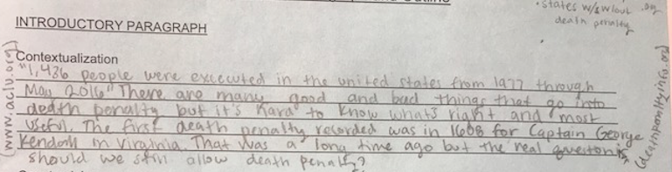
Context Sample

Slide 4
Intro Paragraph – Counterclaim – 1-2 sent.
transition into explaining that there are differing views on the issue
What is an opposing view?
GIVE 1-2 examples of the opposing argument

Slide 5
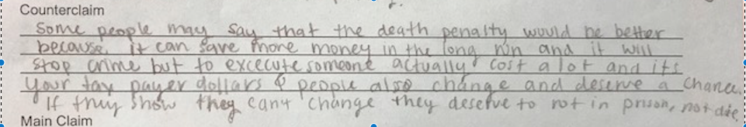
Counterclaim Sample

Slide 6
Intro Paragraph – MAIN CLAIM – 1 sent.
SINGLE SENTENCE
LAST SENTENCE
SHOULD BE ABLE TO STAND ALONE – what does this mean?
Make sure it’s answering the prompt
include 3 sub-claims (which will turn into your supporting paragraphs)

Slide 7
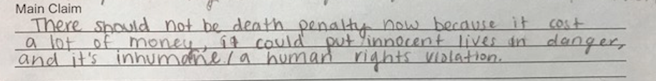
Main Claim Sample

Slide 8
Evidence – 10 points
Be FACTUAL
Use quotations
Statistics
Be specific – not vague
INCLUDE CITATIONS (foxnews, cnn, NYTimes, etc)
Be relevant to your sub-claim and true

Slide 9
Explanations
2 bullet points for each sub-claim
In 1 sentence each - EXPLAIN WHY/HOW your quote/fact/stat matters to your argument.
Connect the dots!!

Slide 10
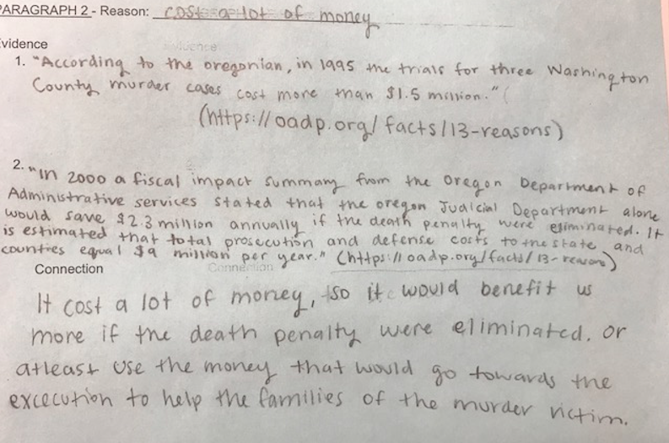
Evidence and Explanation Samples

Slide 11
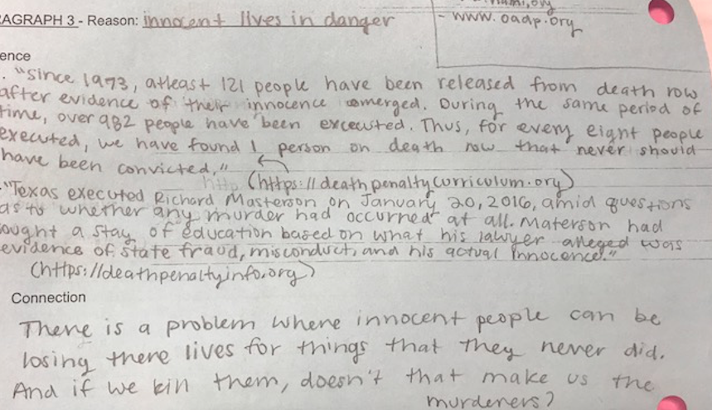

Slide 12
