Slide 1
U.S. Propaganda
World War I

Slide 2
Speeches
“The Part of the Four Minute Man”

Slide 3
Songs from WWI
http://www.firstworldwar.com/audio/overthere.htm
http://www.firstworldwar.com/audio/huntingthehun.htm

Slide 5
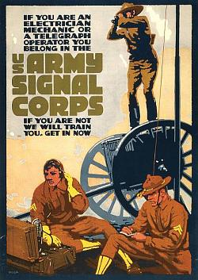

Slide 7
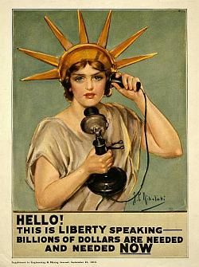

Slide 9
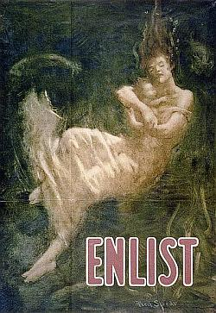

Slide 11
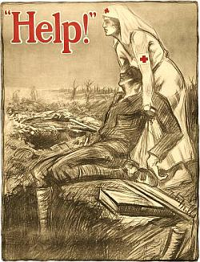

Slide 12
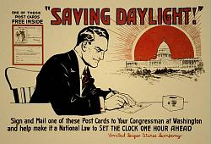

Slide 13
