Slide 1
The Home Front
WWI: What was the common citizens’ role during WWI?

Slide 2
Background Information
mobilizing America,
preparing troops,
getting public support

Slide 3
Wartime Agencies
Government Agencies for the War

Slide 4
War Industries Board
in charge of coordinating the production of war materials –
decided what to produce,
constructing new factories,
setting prices

Slide 5
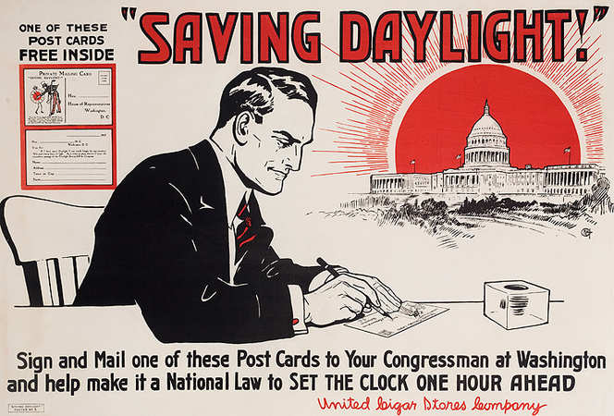
Fuel Administration
management of the nations, use of coal and oil;
creation of daylight savings time,
white house changed – they got sheep to trim the lawn; so they didn’t have to hire a lawn care person; then used their wool to sell for Red Cross money

Slide 6
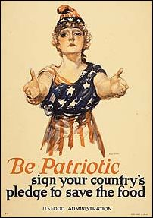
Food Administration
increasing food production,
decreasing civilian consumption
Need more food because food was extremely scarce and we were trying to help feed our allies as well.
War disrupted transportation; farmers turned into soldiers, France and Belgium were starving

Slide 7
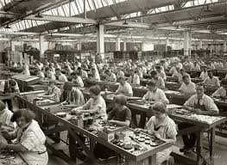
Mobilizing the Workforce
National War Labor Board – made sure that factories were running efficiently and that strikes did not break out (8 hour work days, and higher wages)

Slide 8
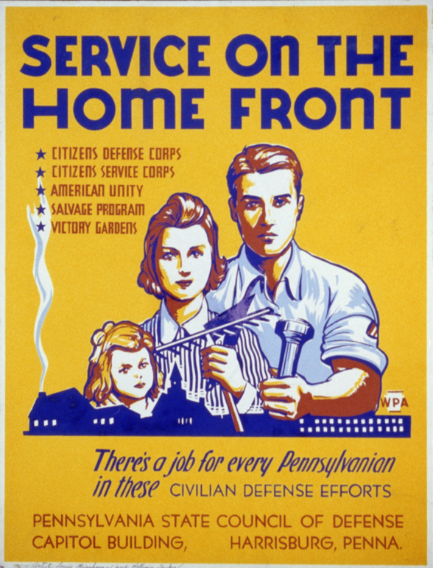
Women in the Workforce
Certain jobs opened for women that had traditionally been men’s jobs.
Women worked in factories, shipyards, and railroads and served as police officers, mail carriers, train engineers

Slide 9
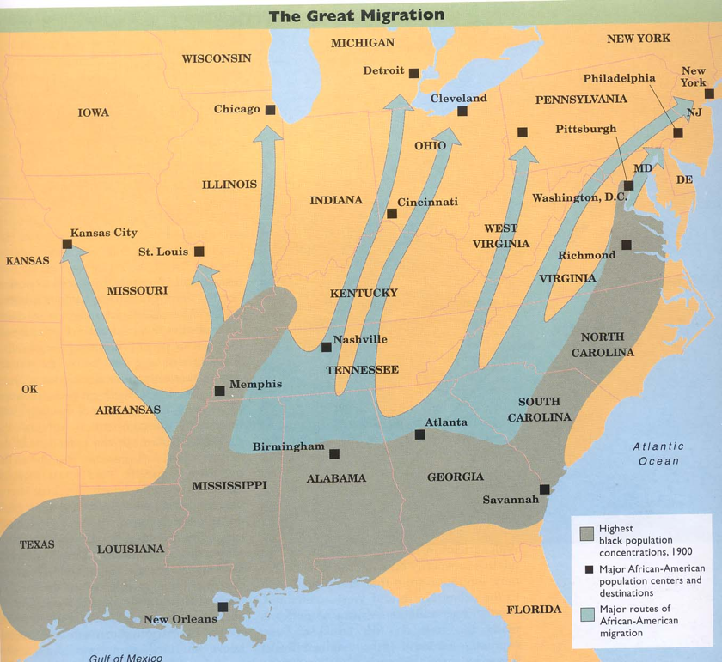
The Great Migration
The workforce was low, desperate for workers, Henry Ford sent company agents south to recruit blacks (300,000 to 500,000)
Altered racial make-up of Chicago, NYC, Cleveland, and Detroit

Slide 10
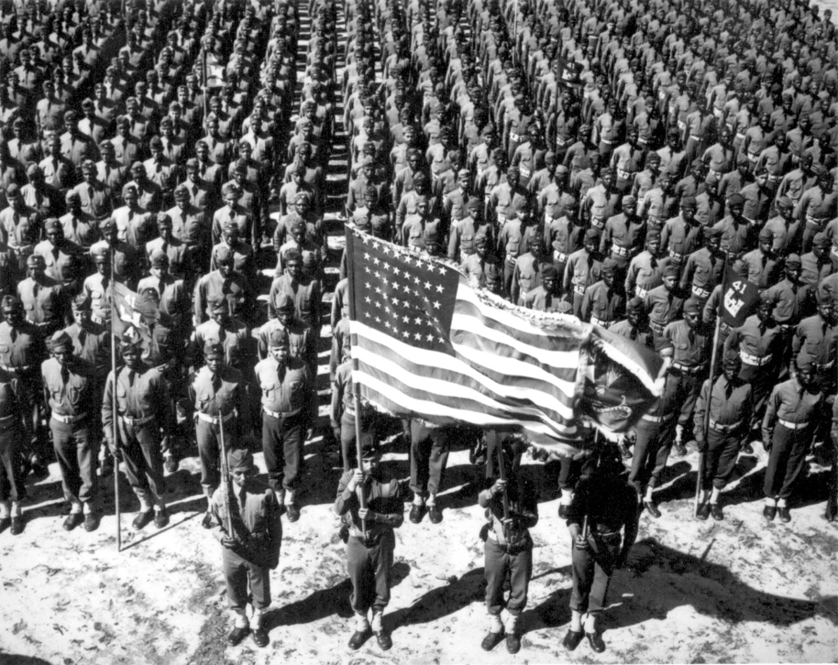
Building the Military

Slide 11
Selective Service
required all men between 21 and 30 to register for a draft lottery,
randomly determined the order in which they were called up.
Called before a local draft board in charge of selecting or exemption people from military service
WHO WOULD YOU CHOOSE???
Draft Board Activity

Slide 12
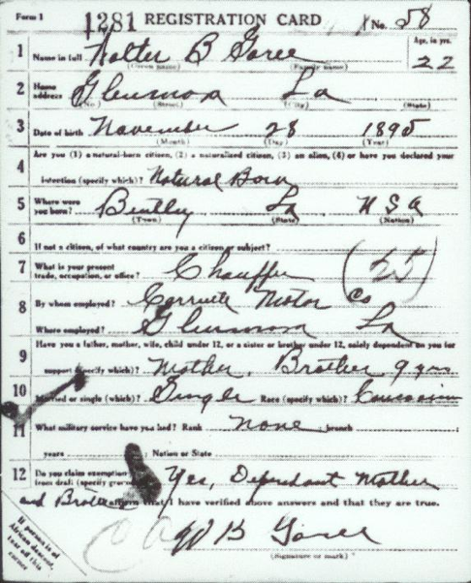
Volunteers
How longs since a big war?
Long time so people wanted to see what a war was like (2 million volunteers)

Slide 13
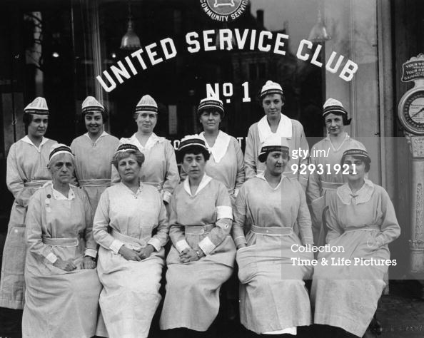
Women
first war in which women serve in the military (non-combat positions)
navy – many clerical positions,
army still refused to allow women to serve

Slide 14
African Americans
Weren’t treated equal
Discriminated against
Whites would not solute them
Forced to eat outside in the winter
Wont receive a change of clothes for months
Rarely given combat positions, mostly labor force.

Slide 15
Primary Source Activity

Slide 16
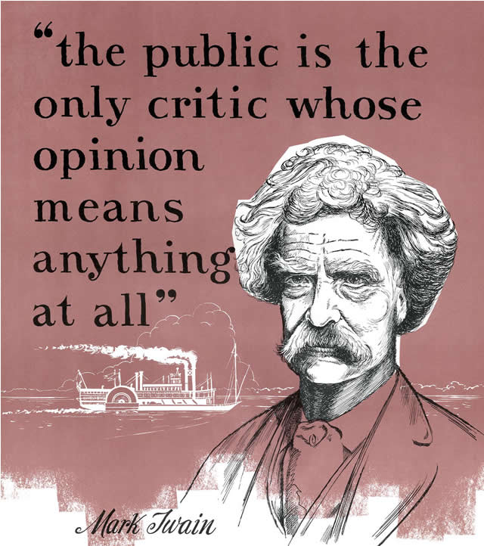
Shaping Public Opinion

Slide 17
Committee on Public Information
Advertising , artists, authors, songwriters, entertainers, public speakers, and motion picture companies to help sway public opinion in favor of the war

Slide 18
Espionage
Government wanted to limit opposition to the war and fight espionage (spying)

Slide 19
Survey Activity
You have 5 minutes!!!
Do NOT interrupt a class.
Find a teacher on Prep, an office aid, librarian, etc.

Slide 20
Espionage Act of 1917
illegal to aid the enemy, give false reports, or interfere with the war effort

Slide 21
Sedition Act of 1918
illegal to speak against the war publicly

Slide 22
Conflict
many people thought this was a violation of their civil liberties (1st amendment –freedom of speech)

