Slide 1
The Gilded Age
The Transcontinental Railroad

Slide 2
The Pacific Railway Act
Provided construction of a transcontinental railroad by two corporations
Encouraged rapid construction, the Government offered each company land along its path
A competition developed as each raced to obtain as much land as possible!

Slide 3
The Union Pacific
Led by Grenville Dodge
Started westward from Omaha, Nebraska in 1865
Laid 1,086 miles of rails
Workers included: Civil War vets, Irish immigrants, miners, farmers, cooks, adventurers, and ex-convicts – at the height of the project they employed 10,000 workers
Faced blizzards in the mountains, blistering heat in the summer and angry Natives

Slide 4
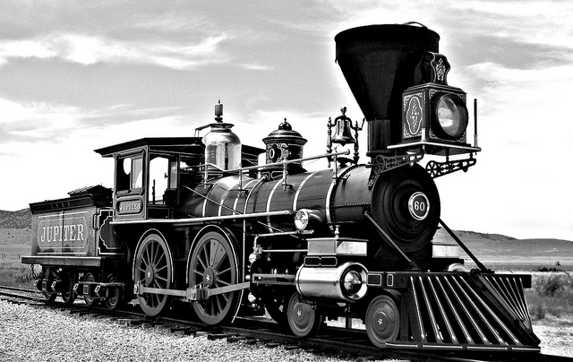
The Central Pacific
Directed by Theodore Judah
Started on the west coast heading east
Hired about 10,000 Chinese workers and paid them $1.00 a day
All equipment was shipped from the Eastern United States
Laid 688 miles

Slide 6
Additional Facts
Took 4 years to complete
May 10, 1869 – Promontory Summit, Utah – where the two companies met and drove in the last spike! Huge celebration!
Benefits: Increased other industries such as steel, iron, and coal
West bursts in population (formally 100 days turned into 6-8 days of travel time)
The Beginning of the Industrial period

