Slide 1
Nixon’s Foreign Policy

Slide 2
Vietnamization
Policy to end US involvement in the war
“Expand, equip, and train South Vietnam’s forces and assign them to an ever-increasing combat role, at the same steadily reducing the number of U.S. combat troops.”
Campaigned on this idea and ending the war
Americans are very happy

Slide 3
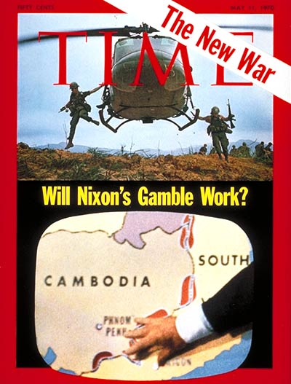
The Invasion of Cambodia
Purpose was to disrupt the North Vietnamese supplies lines and bomb/destroy Viet Cong base camps
Announced by Nixon on April 30, 1970
https://www.youtube.com/watch?feature=player_embedded&v=rDSsDBieVGE
In reality, Nixon had been ordering bombings on Cambodia for months before actual invasion declaration
Americans felt betrayed and shocked
As a result, peaceful and violent protests erupted all over the county

Slide 4
Kent State Massacre
Occurred at Kent State University – Protest in response to Cambodian Invasion
Involved the shooting of unarmed college students by the Ohio National Guard on Monday, May 4, 1970.
Guardsmen fired 67 rounds over a period of 13 seconds, killing four students and wounding nine others, one of whom suffered permanent paralysis.
Some of the students who were shot had been protesting the Cambodian Campaign, which President Richard Nixon announced during a television address on April 30.
Other students who were shot had been walking nearby or observing the protest from a distance.

Slide 8
War Powers Resolution of 1973
Given in response to Invasion of Cambodia
Requires president to notify Congress within 48 hours of committing armed forces to military action
Forbids armed forces from remaining for more than 60 days, with a further 30 day withdrawal period, without the authorization of the use of military force or declaration of war
Passed over Nixon’s veto

Slide 9
Détente
Look up this definition in your book.
After reading through the definition, put it in your own words. What is détente?

Slide 10
Opening Relations with China
http://www.cfr.org/world/lessons-learned-richard-nixon-goes-china/p27369
As you watch this clip, jot down notes on Nixon’s efforts to build relations with China AND the role diplomacy plays in Foreign Affairs.

Slide 11
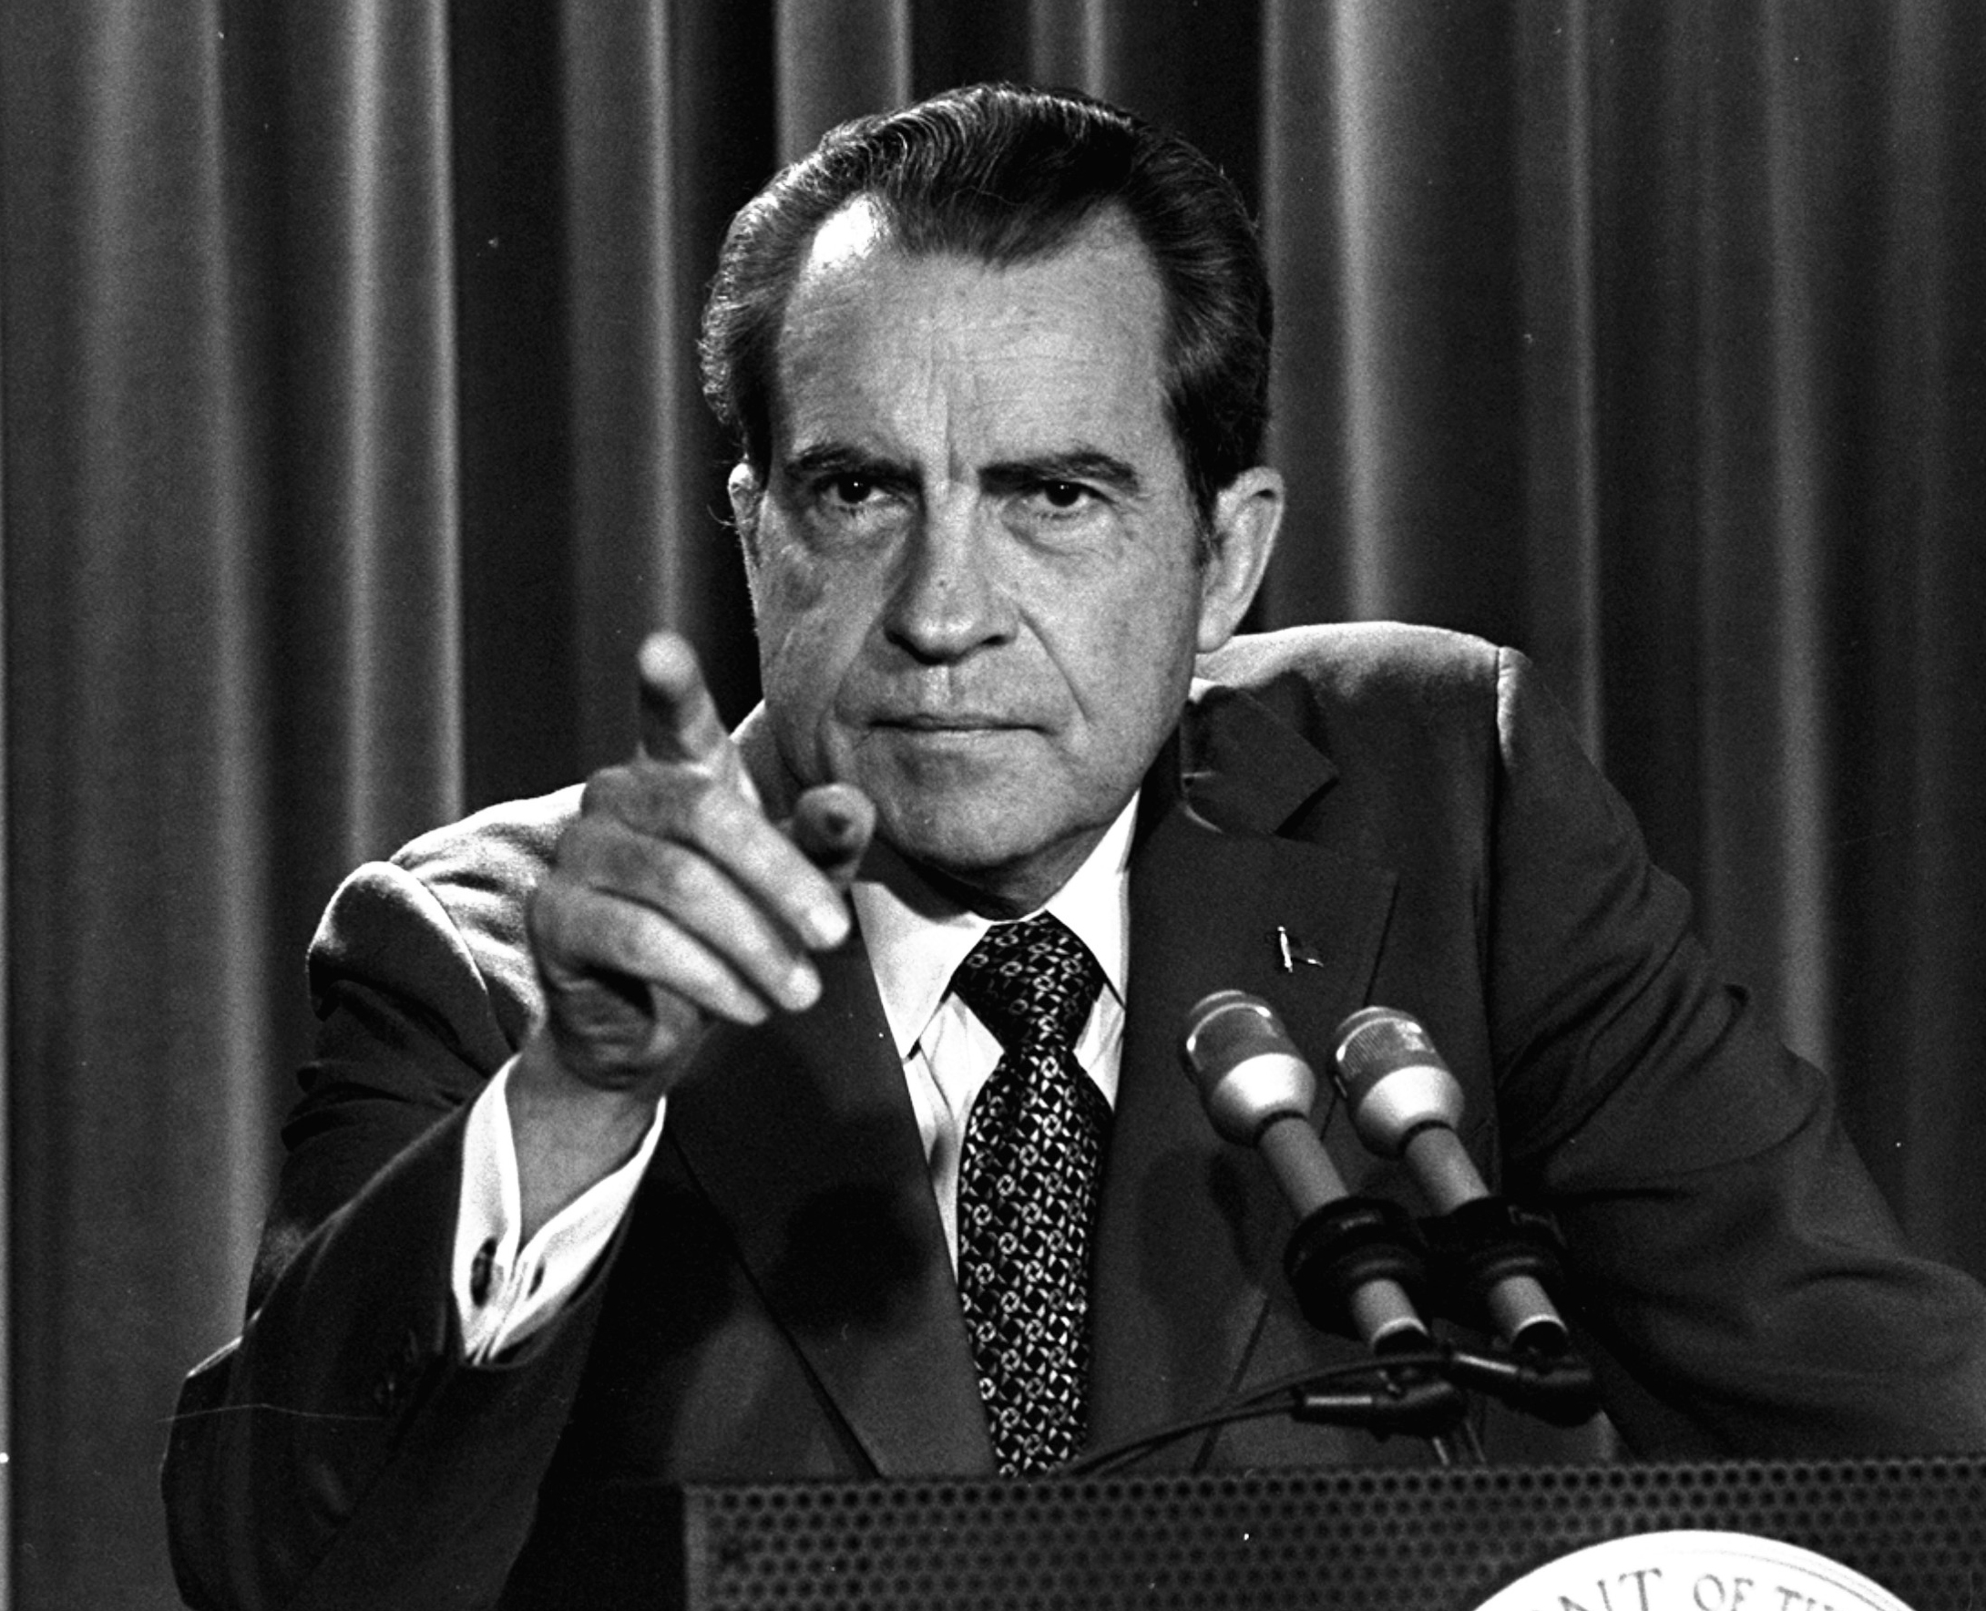
SALT I Agreement
May 1972
Talk between the US and Soviet Union
Led to an anti-ballistic missile treaty (reducing arms)
This is the first step towards slowing down the building of Nuclear Weapons.

Slide 12
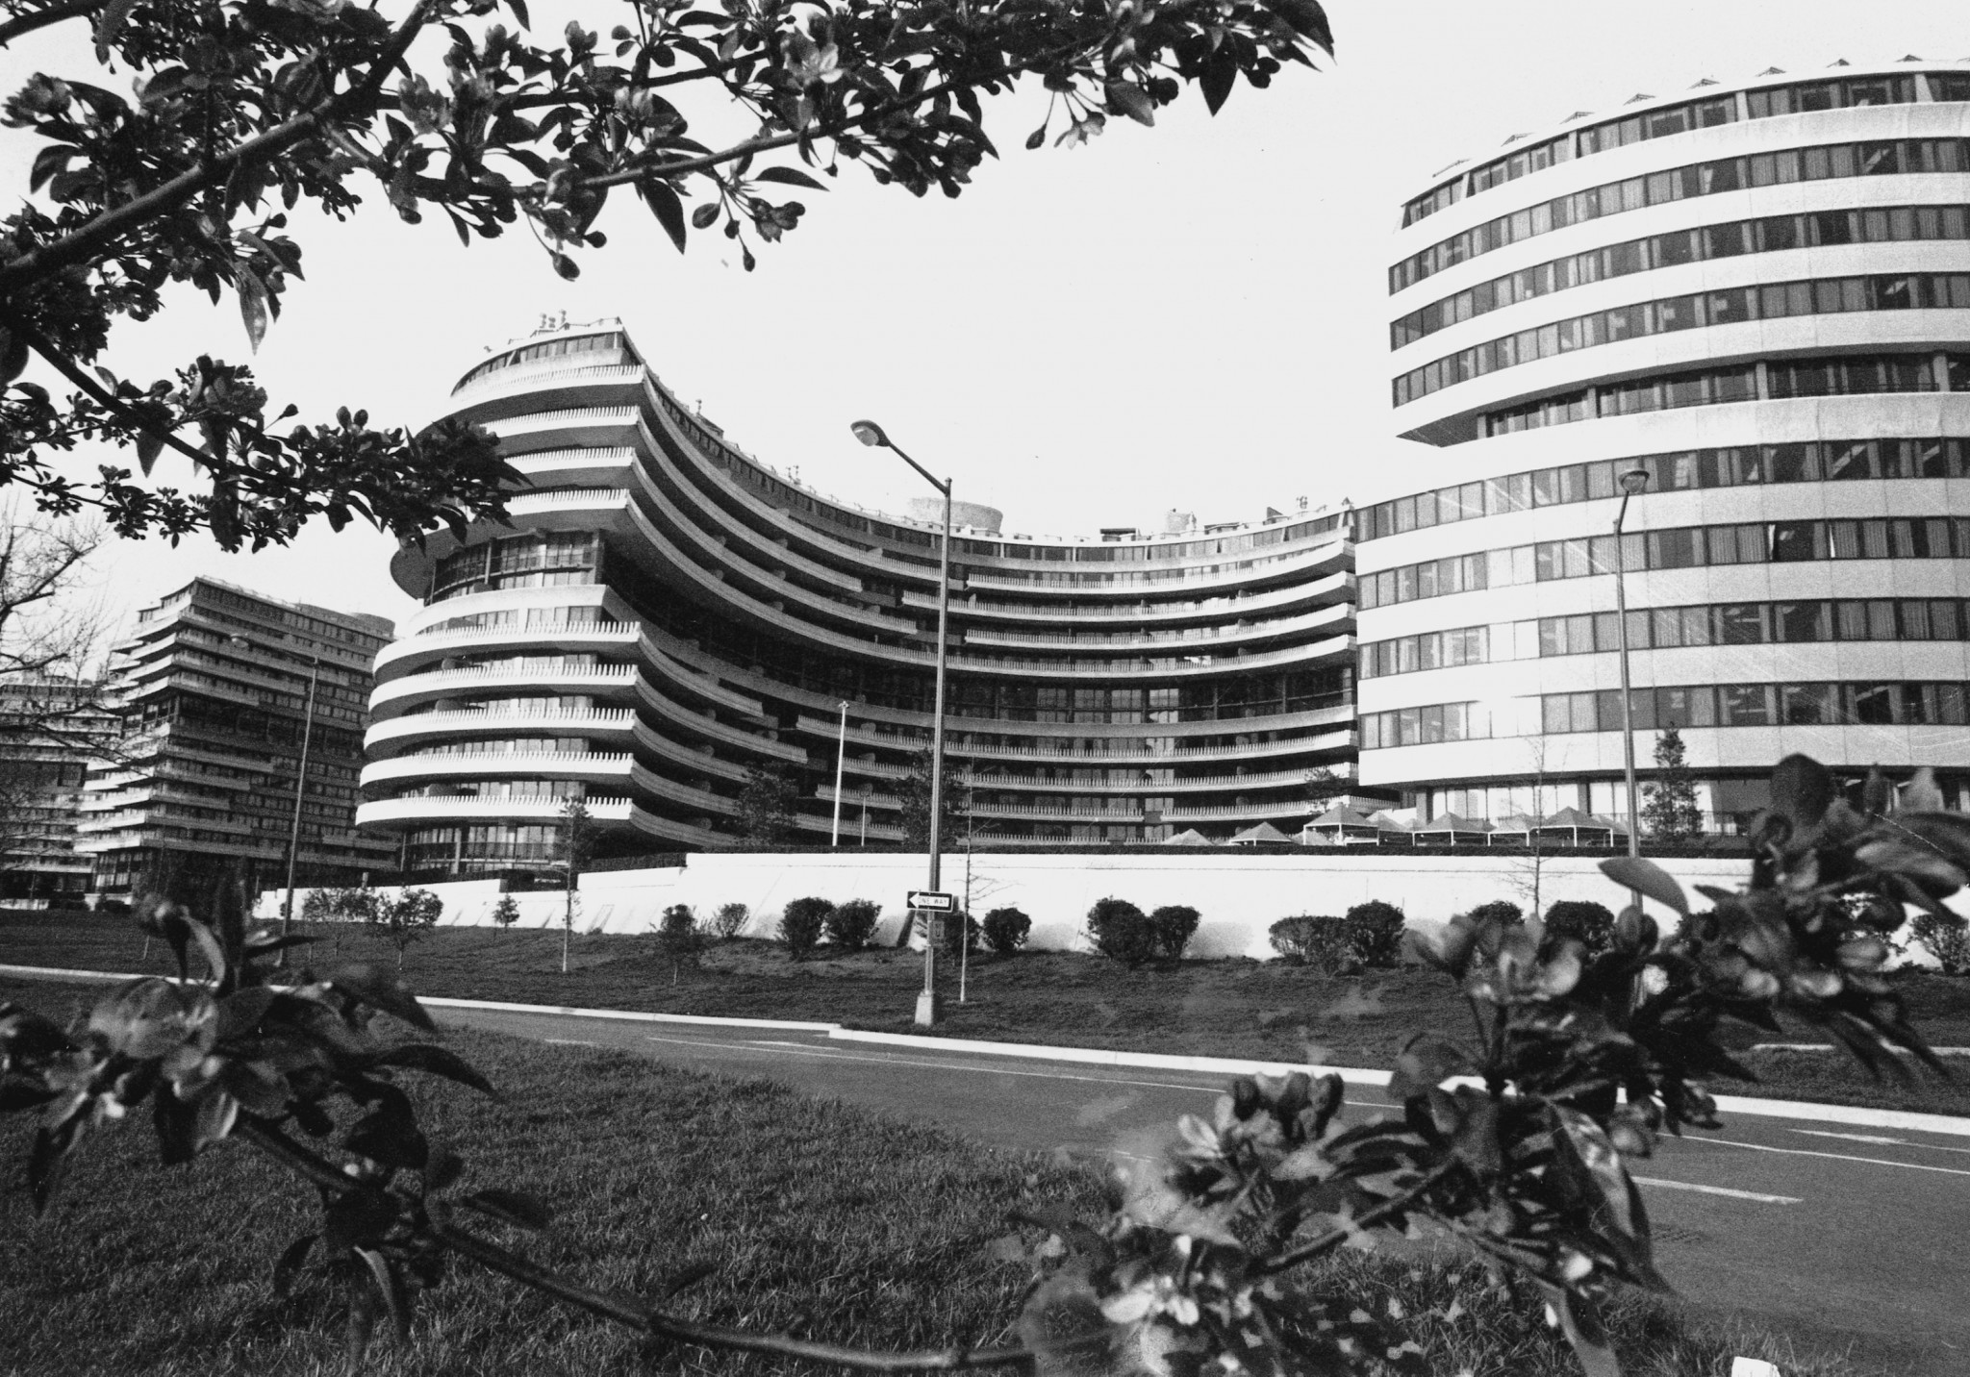
Watergate
As you watch the video, answer the questions in your notes.
https://www.youtube.com/watch?v=IHnmriyXYeg

Slide 13
Watergate Primary Source
Read the document with a partner...
Jot notes on arguments of why Nixon is guilty and why he is innocent.
Write your own opinion in the space provided...
Wait to take notes on what actually happened...

Slide 14
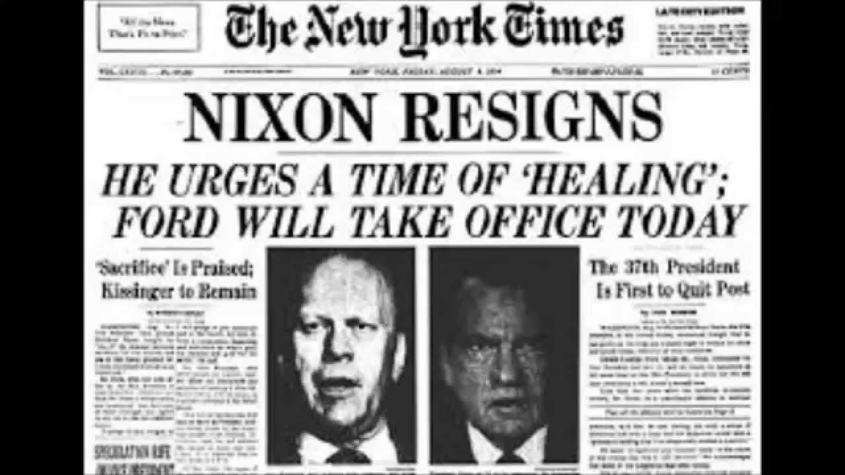
What actually happened...
Nixon resigned before the Senate took it to a vote...so he was NOT impeached.
Why do you think Nixon Resigned?
What does this suggest/imply?

