Slide 1
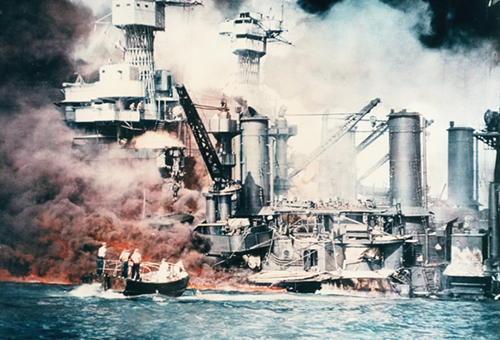
The Attack on Pearl Harbor
December 7, 1941
“A date which will live in infamy.”

Slide 2
“Need-to-Knows”
* Date: December 7, 1941
* Location: Pearl Harbor, Hawaii Territory
* War Results: 1.) Japanese major victory 2.) U.S. Declaration of War on Japan 3.) Germany and Italy Declare War on the U.S. (Tripartite Pact) 4.) U.S. Declares War on Germany and Italy
* Battle Results: 1.) All eight U.S. Navy battleships were damaged, with four being sunk 2.) Three cruisers, three destroyers, an anti-aircraft ship and one minelayer ship were sank or damaged 3.) 188 U.S. aircraft were destroyed (Pacific Fleet!)
* Deaths/Casualties: 1.) 2,402 killed (65) 2.) 1,282 wounded (1 captured)

Slide 3
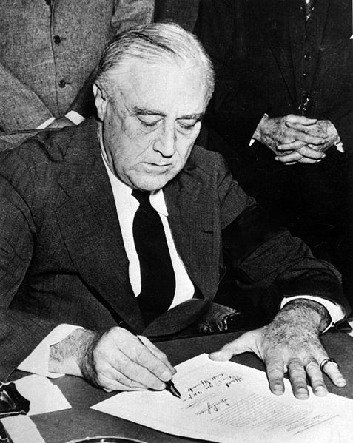
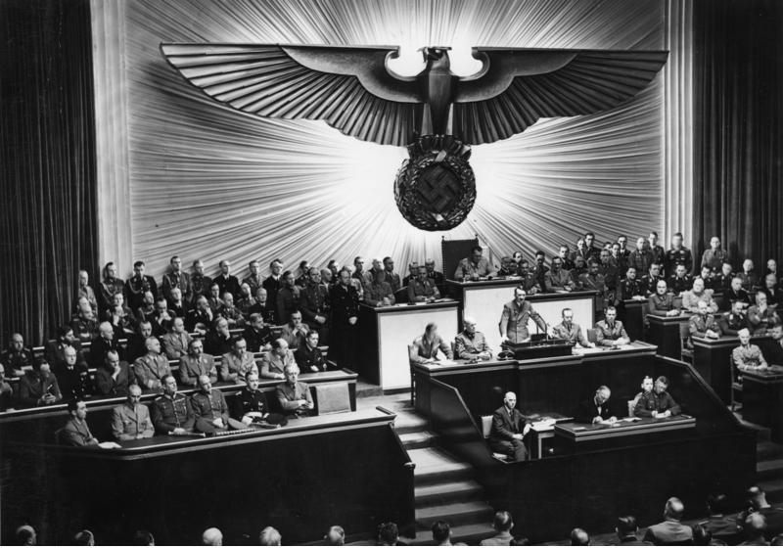
Results for American Government
* Domestic support for non-interventionism (isolation) disappeared!
* Underground support of Britain was replaced by an active alliance!

Slide 4
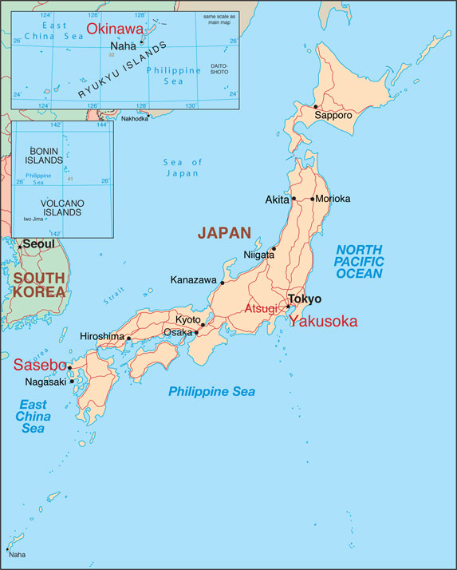
Background to the Attack…
* How did the Japanese feel about Western nations?
* What problems does Japan encounter in the 1920s and 30s?
* As an ISLAND NATION – what problems does Japan encounter?
Notes:
As an island nation, Japan had developed a rich and complex social structure. It resisted westernization by sealing itself off from contact with the outside world, particularly Europe and the United States.
By the early twentieth century, though, Japan's efforts to achieve self-sufficiency were failing, for the nation lacked its own raw materials and other resources. Some members of the ruling class argued that Japan could grow and prosper only by modernizing and adopting Western technology. Japanese nationalists, though, advocated a different path: the establishment of an empire that would not only elevate Japan's stature in the eyes of the world but also guarantee access to the resources the nation needed. Moreover, many members of the nation's traditional warrior class—the Samurai—were embittered by the aftermath of World War I. Japan had backed the victorious Allies, but the Samurai believed that in the peace negotiations following the war the United States and Great Britain had treated Japan as a second-class nation. They, too, longed to assert Japan's place in world affairs.

Slide 5
Japanese Aggression Prior to
Attack on Pearl Harbor
1.) 1933, Japan withdrew from the League of Nations (after criticism for Manchurian Incident, 1931)
2.) 1937, the second Sino-Japanese War broke out (and Japan essentially controlled east coast of China until 1945)
3.) France Falls (June 1940), * Battle of Britain Ends * (Oct. 1940), Japan Occupies French Indochina (Sept. 1940), G.B. and U.S. react with an embargo on “strategic materials” of Japan! (airplane fuel, scrap metal, oil, steel, etc.)
Notes:
1933, Japan withdrew from the League of Nations since she was heavily criticized for her actions in China.
July 1937, the second Sino-Japanese War broke out. A small incident was soon made into a full scale war by the Kwantung army which acted rather independently from a more moderate government. The Japanese forces succeeded in occupying almost the whole coast of China and committed severe war atrocities on the Chinese population, especially during the fall of the capital Nanking. However, the Chinese government never surrendered completely, and the war continued on a lower scale until 1945.
In 1940, Japan occupied French Indochina (Vietnam) upon agreement with the French Vichy government, and joined the Axis powers Germany and Italy. These actions intensified Japan's conflict with the United States and Great Britain which reacted with an oil boycott. The resulting oil shortage and failures to solve the conflict diplomatically made Japan decide to capture the oil rich Dutch East Indies (Indonesia) and to start a war with the US and Great Britain.
Japan began to flex its muscles in 1931. Japanese forces stationed in Manchuria, northeast of China, to protect a Japanese railway that transported goods and raw materials out of the country suddenly seized control of all of Manchuria. Then in 1937, Japanese forces attacked the eastern provinces of China, seizing China's capital, Nanking, and the old capital, Beijing, in brutal fashion. Observers in the West were horrified by reports of the atrocities against civilians committed by Japanese invaders in the so-called "Rape of Nanking."

Slide 6
Japanese Aggression Prior to
Attack on Pearl Harbor
*** September 1940, Japan occupied French Indochina – Vietnam (agreement with the French Vichy government – Tripartite Pact signed!) ***
*Why didn’t Great Britain enjoy Japan’s
presence in French Indochina? *
Japan proved to be a direct threat to British colonies in S.E. Asia! (Malaya)
* As a result of Japanese aggression, FDR sends “lend-lease” supplies to China – who does that tick off even more??? (he also freezes Japanese assets in the U.S. and send Douglas MacArthur to the Philippines to prepare a Pacific Fleet)

Slide 7
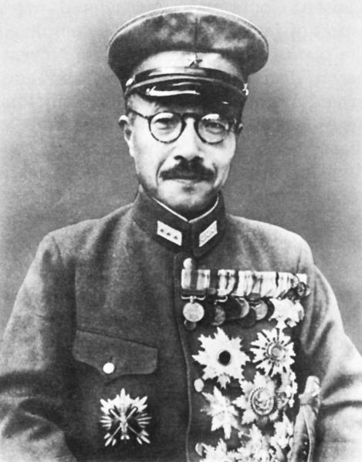
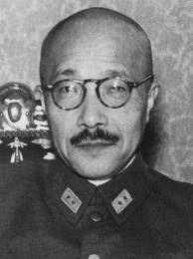
Hideki Tojo: Prime Minister of Japan (Former Minister of War)
"Greater East Asia Co-Prosperity Sphere"
Notes:
Under the leadership of Minister of War Hideki Tajo, Japan's objective was to establish a defensive perimeter—the "Greater East Asia Co-Prosperity Sphere"—in the western Pacific. This perimeter was to extend from the Juries Islands northeast of Japan, south to the Marianas and Marshall Islands, west through the Solomon Islands, New Guinea, and the East Indies, then northward into the Indian Ocean and southeast Asia. Tajo believed that Japan could thus drive out the Western powers, achieve a position of preeminence in East Asia, and free the nation from its dependence on Western oil, coal, rubber, ore, and other vital resources.
Tojo's strategy, however, was bringing him ever closer to conflict with those powers. The Dutch, for example, controlled the East Indies, France had a presence in Indo-China, the United States controlled the Philippines, and Malaya was a British colony. Concerned about Japanese aggression, Holland, Great Britain, and the United States imposed a trade embargo on Japan on July 26, 1941, cutting off supplies of resources to the increasingly belligerent nation. Tojo, now prime minister, was convinced that the West's goal was to starve Japan into submission.
Events came to a boil in September, 1941. United States Secretary of State Cordell Hull demanded that Japan withdraw its troops from China and Southeast Asia. While many Japanese military leaders quailed at the prospect of going to war with the United States, Tojo convinced them that acceding to American demands would be a humiliating diplomatic defeat. While carrying on protracted—and deceptive—negotiations with the United States, Japan invaded Thailand, Malaya, Burma, and the East Indies. And on November 26, the Japanese navy set sail for Pearl Harbor, where most of the U.S. Pacific fleet was docked.

Slide 8
* Why did the Japanese attack Pearl Harbor? *
The ENTIRE Pacific fleet was stationed at Pearl Harbor; the Japanese felt that if they could cripple the Pacific fleet, it would allow them to move freely throughout the Pacific ocean! (Greater East Asia Co-Prosperity Sphere)

Slide 9
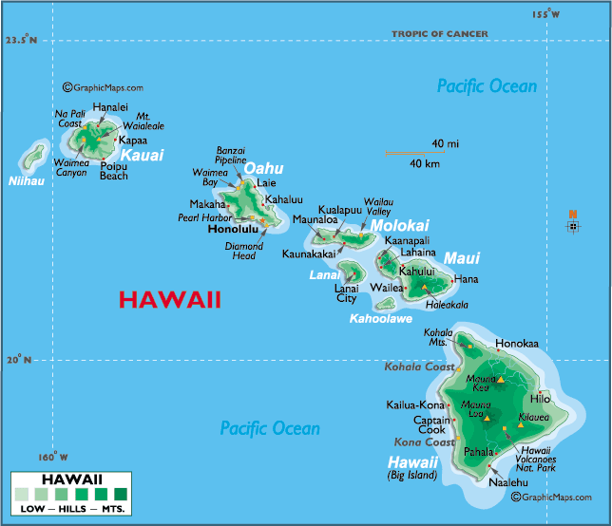

Slide 10
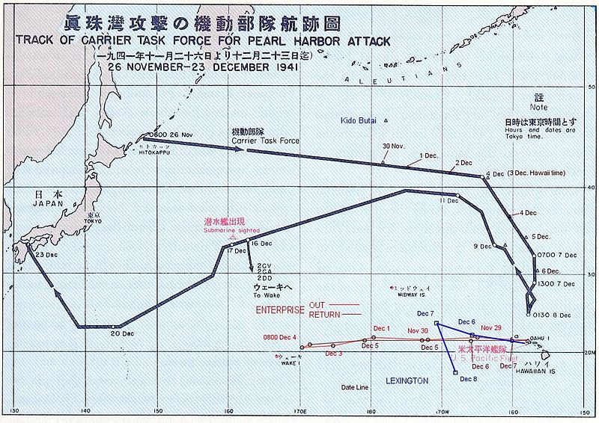
* Tokyo to Oahu= Approx. 3,900 miles (Miami to Seattle is only 3,300 miles!)

Slide 11
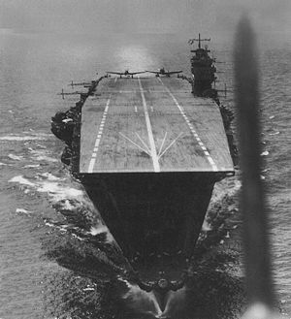
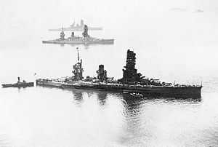
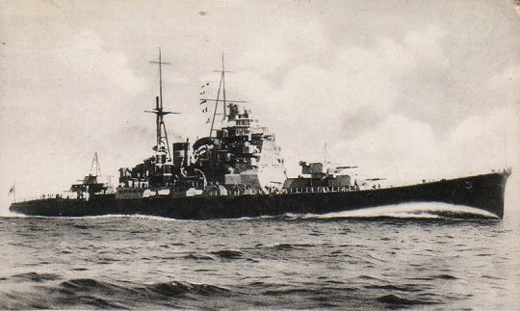
* How did the Japanese battle fleet fly nearly 3,900 miles undetected across the Pacific Ocean???
* Six aircraft carriers, two battleships, two cruisers, and nine destroyers traveled under strict radio silence and screened from view by a large weather front! (came within two hundred miles of the Hawaiian Islands)
Notes:
On November 26, 1941, a Japanese task force (the Striking Force) of six aircraft carriers (Akagi, Kaga, Sōryū, Hiryū, Shōkaku, and Zuikaku) departed northern Japan en route to a position northwest of Hawaii, intending to launch its aircraft to attack Pearl Harbor. In all, 408 aircraft were intended to be used: 360 for the two attack waves, 48 on defensive combat air patrol (CAP), including nine fighters from the first wave…

Slide 12
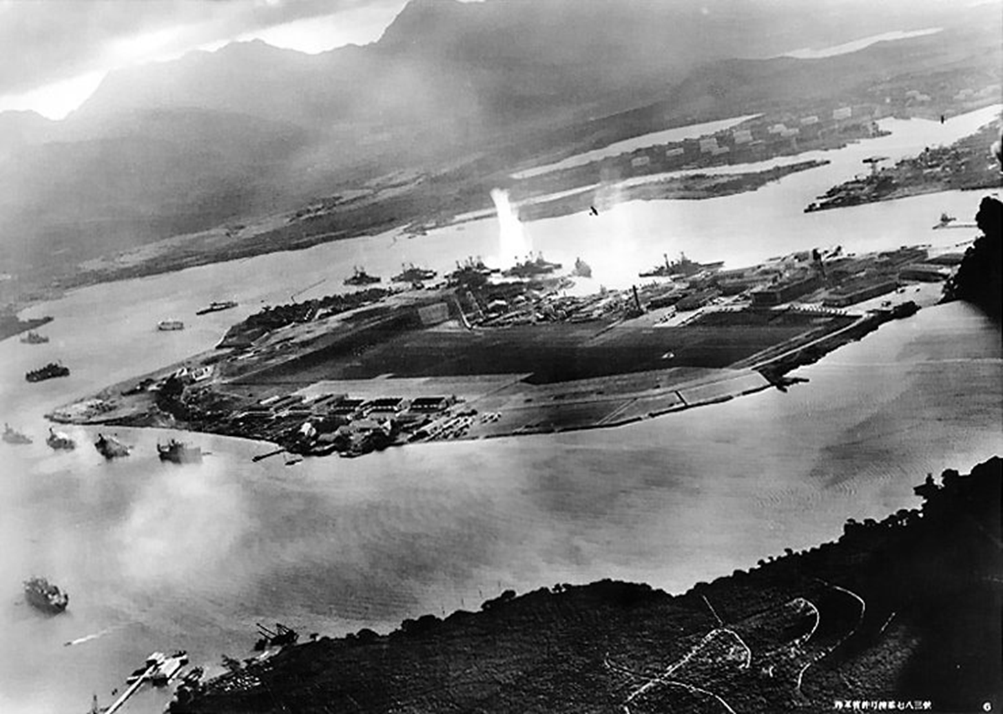
The Attack!
Notes:
Photograph taken from a Japanese plane during the torpedo attack on ships moored on both sides of Ford Island shortly after the beginning of the Pearl Harbor attack. View looks about east, with the supply depot, submarine base and fuel tank farm in the right center distance.
A torpedo has just hit USS West Virginia on the far side of Ford Island (center). Other battleships moored nearby are (from left): Nevada, Arizona, Tennessee (inboard of West Virginia), Oklahoma (torpedoed and listing) alongside Maryland, and California.
On the near side of Ford Island, to the left, are light cruisers Detroit and Raleigh, target and training ship Utah and seaplane tender Tangier. Raleigh and Utah have been torpedoed, and Utah is listing sharply to port.
Japanese planes are visible in the right center (over Ford Island) and over the Navy Yard at right. U.S. Navy planes on the seaplane ramp are on fire.
Japanese writing in the lower right states that the photograph was reproduced by authorization of the Navy Ministry.

Slide 13
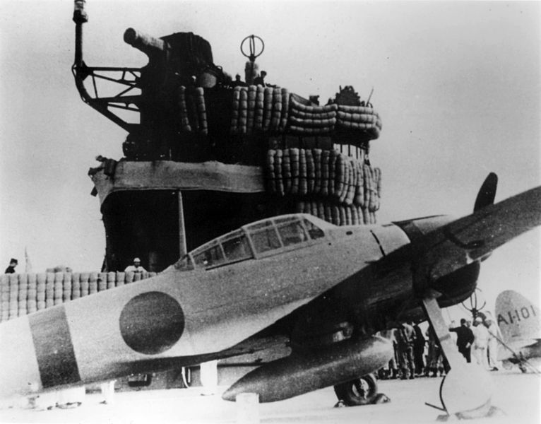
The Attack!
* Morning of Dec. 7, 183 torpedo bombers and dive-bombers took off from the Japanese fleet (250 miles NW of Hawaii)
* The Japanese attacked in two waves (first wave, primary attack – second wave, the finisher!)
* The first wave was detected by U.S. Army radar, but was misidentified as USAAF bombers arriving from the American mainland!

Slide 14
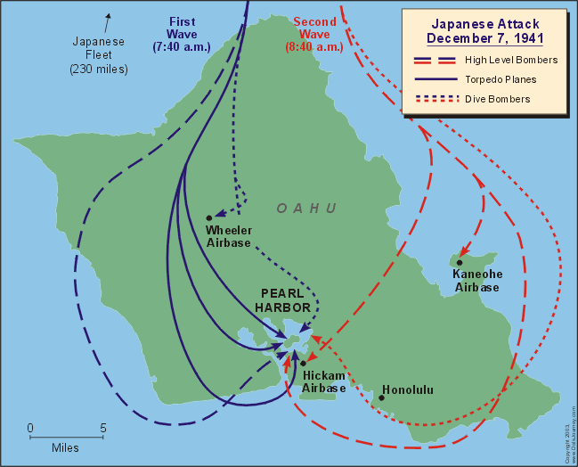
Notes:
The attack. Traveling under strict radio silence and screened from view by a large weather front, the Japanese battle fleet—six aircraft carriers, two battleships, two cruisers, and nine destroyers—remained undetected until it came within two hundred miles of the Hawaiian Islands. On the morning of December 7, 183 torpedo bombers and dive-bombers took off from the aircraft carriers.
The Japanese pilots knew exactly where they were going because spies on the islands had given them elaborate and detailed scale models of the base, including Battleship Row. Because it was Sunday morning, most of the U.S. naval personnel were ashore, and most of the antiaircraft defenses were unmanned.
At 7:49 AM local time, the attack began—and by 8:12, much of the fleet had been damaged or sunk. A second wave of bombers arrived at nine o'clock to finish what the first wave had started. In a little more than an hour, the United States fleet was severely crippled. Two days later, on December 9, the United States declared war on Japan.
The first wave was to be the primary attack, while the second wave was to finish whatever tasks remained.
The first wave contained the bulk of the weapons to attack capital ships… The aircrews were ordered to select the highest value targets (battleships and aircraft carriers) or, if these were not present, any other high value ships (cruisers and destroyers).
Dive bombers were to attack ground targets. Fighters were ordered to strafe and destroy as many parked aircraft as possible to ensure they did not get into the air to counterattack the bombers, especially in the first wave. When the fighters' fuel got low they were to refuel at the aircraft carriers and return to combat. Fighters were to serve CAP duties where needed, especially over US airfields.

Slide 15
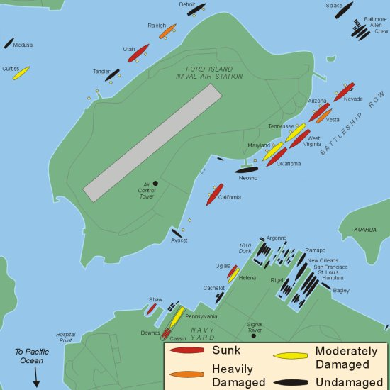
“Battleship Row”
Outside of Ford Island, Pearl Harbor
Notes:
Battleship Row was the grouping of eight U.S. battleships in port at Pearl Harbor, Hawaii, when the Japanese attacked on 7 December 1941…
These ships bore most of the brunt of the Japanese assault. They were moored next to Ford Island when the attack commenced. The ships were Arizona, California, Maryland, Nevada, Oklahoma, Pennsylvania, Tennessee, and West Virginia. A repair ship (former coal ship), Vestal, was also present, moored next to Arizona…

Slide 16
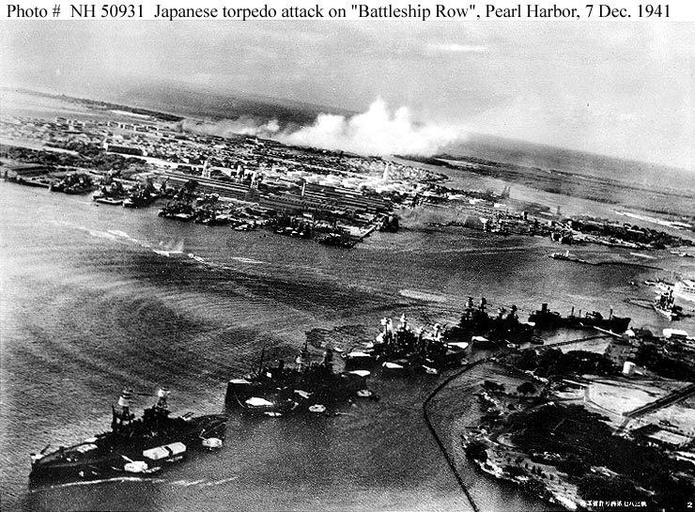
Notes:
Torpedo planes attack "Battleship Row" at about 0800 on 7 December, seen from a Japanese aircraft. Ships are, from lower left to right: Nevada (BB-36) with flag raised at stern; Arizona (BB-39) with Vestal (AR-4) outboard; Tennessee (BB-43) with West Virginia (BB-48) outboard; Maryland (BB-46) with Oklahoma (BB-37) outboard; Neosho (AO-23) and California (BB-44).
West Virginia, Oklahoma and California have been torpedoed, as marked by ripples and spreading oil, and the first two are listing to port. Torpedo drop splashes and running tracks are visible at left and center.
White smoke in the distance is from Hickam Field. Grey smoke in the center middle distance is from the torpedoed USS Helena (CL-50), at the Navy Yard's 1010 dock.

Slide 17
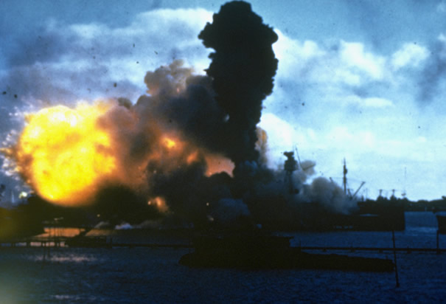
USS Arizona
Notes:
USS Arizona Burning at Pearl Harbor: The USS Arizona burns after being hit by a Japanese bomb in Pearl Harbor, December 7, 1941.

Slide 18
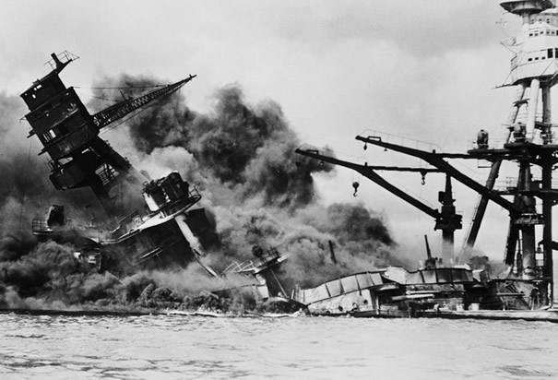
USS Arizona
Notes:
USS Arizona Burning and Sinking: The Arizona was the US battleship that sustained the most damage and had the most casualties during the attack on Pearl Harbor.

Slide 19
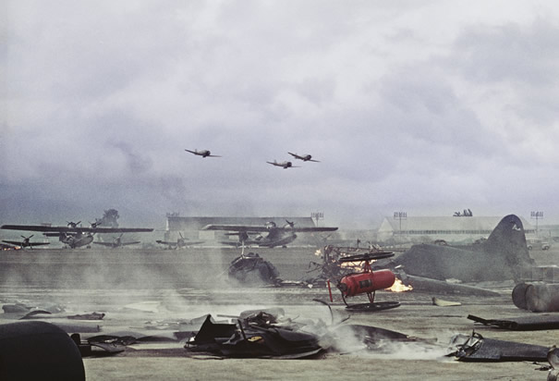
Bombing of Wheeler Field

Slide 20
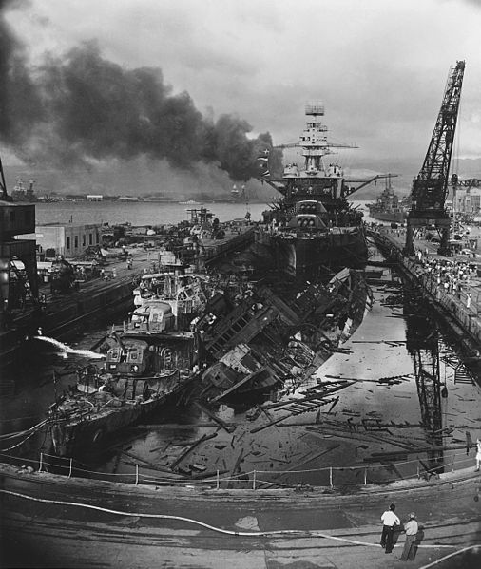
Notes:
The wrecked destroyers USS Downes (DD-375) and USS Cassin (DD-372) in Drydock One at the Pearl Harbor Navy Yard, soon after the end of the Japanese air attack. Cassin has capsized against Downes. USS Pennsylvania (BB-38) is astern, occupying the rest of the drydock. The torpedo-damaged cruiser USS Helena (CL-50) is in the right distance, beyond the crane. Visible in the center distance is the capsized USS Oklahoma (BB-37), with USS Maryland (BB-46) alongside. The smoke is from the sunken and burning USS Arizona (BB-39), out of view behind Pennsylvania. USS California (BB-44) is partially visible at the extreme left…

Slide 21
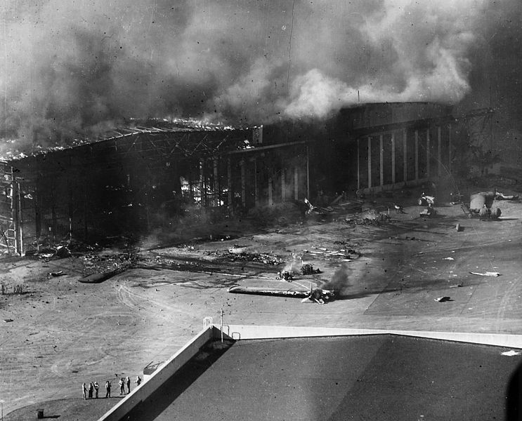
Ford
Island
Notes:
U.S. Navy planes and a hangar burning at the Ford Island Naval Air Station's seaplane base, during or immediately after the Japanese air raid on Pearl Harbor, Hawaii (USA), on 7 December 1941. The ruined wings of a Consolidated PBY Catalina patrol plane are at left and in the center. Note men with rifles standing in the lower left…

Slide 22
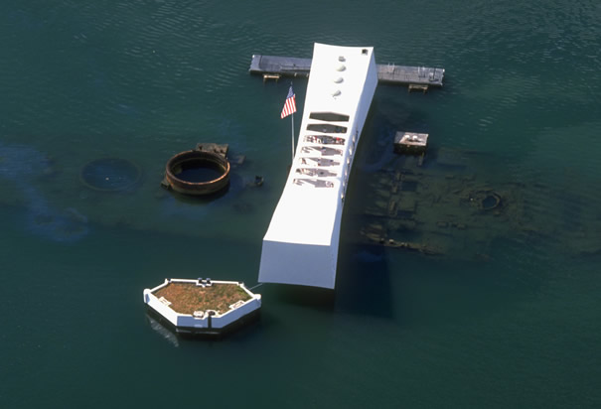
USS Arizona Memorial
Notes:
Aerial View of USS Arizona Memorial: The USS Arizona Memorial seen from above. The memorial was built on top of the sunken remains of the Arizona. Much of the hull remains and oil continues to slowly leak into the water

Slide 23
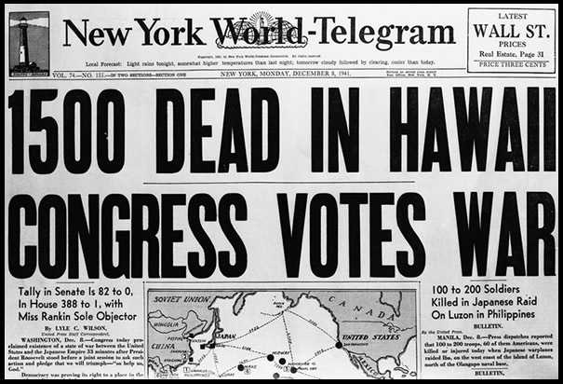
Notes:
Newspaper Headline After Pearl Harbor Attacks: The headlines of the New York World-Telegram on Monday December 8, 1941 announce the attacks on Pearl Harbor.

Slide 24
FDR Responds to Pearl Harbor
“Yesterday, December 7, 1941 – a date which will live in infamy – the United States of America was suddenly and deliberately attacked by naval and air forces of the Empire of Japan. The United States was at peace with that nation, and, at the solicitation of Japan, was still in conversation with its government and its emperor looking toward the maintenance of peace in the Pacific. Indeed, one hour after Japanese air squadrons had commenced bombing in the American island of Oahu, the Japanese ambassador to the United States and his colleague delivered to our secretary of state a formal reply to a recent American message. While this reply stated that it seemed useless to continue the existing diplomatic negotiations, it contained no threat or hint of war or armed attack. It will be recorded that the distance of Hawaii from Japan makes it obvious that the attack was deliberately planned many days or even weeks ago. During the intervening time the Japanese government has deliberately sought to deceive the United States by false statements and expressions of hope for continued peace. The attack yesterday on the Hawaiian Islands has caused severe damage to American naval and military forces. I regret to tell you that very many American lives have been lost.” – FDR, Dec. 8, 1941
Did You Know? The single vote against Congress's declaration of war came from Rep. Jeannette Rankin of Montana. Rankin was a pacifist who had also voted against the American entrance into World War I. “As a woman,” she said, “I can’t go to war, and I refuse to send anyone else.”
Notes:
After the Pearl Harbor attack, and for the first time after years of discussion and debate, the American people were united in their determination to go to war. The Japanese had wanted to goad the United States into an agreement to lift the economic sanctions against them; instead, they had pushed their adversary into a global conflict that ultimately resulted in Japan’s first occupation by a foreign power.
On December 8, Congress approved Roosevelt’s declaration of war. Three days later, Japanese allies Germany and Italy declared war against the United States. For the second time, Congress reciprocated. More than two years after the start of the conflict, the United States had entered World War II…

Slide 25
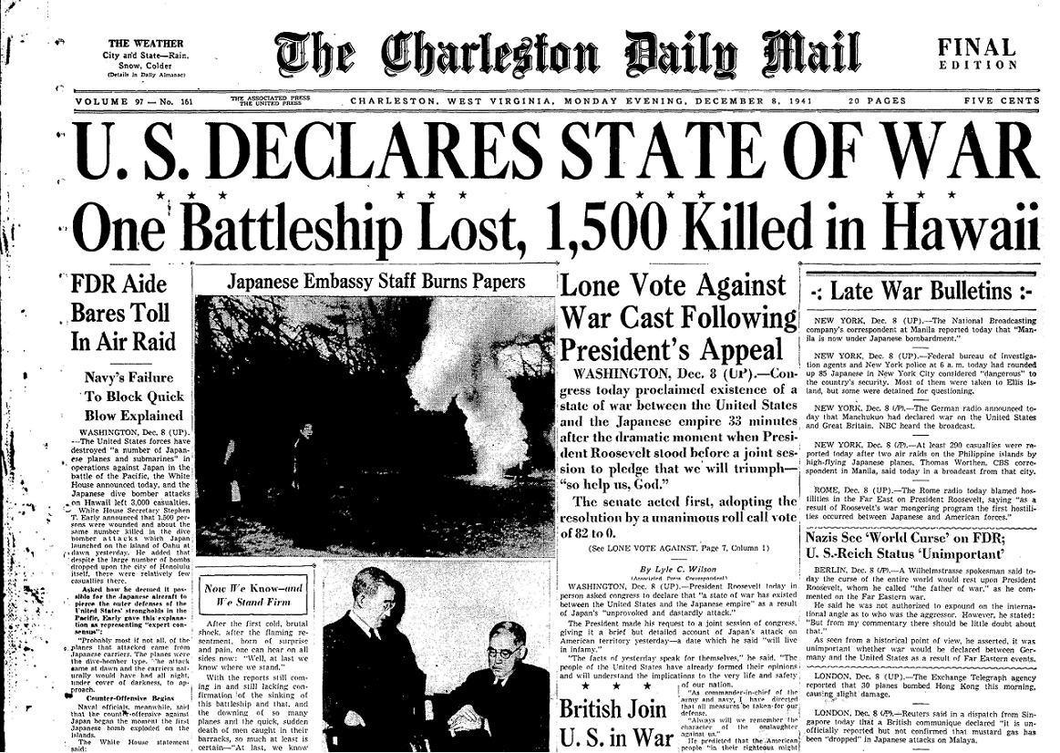

Slide 26
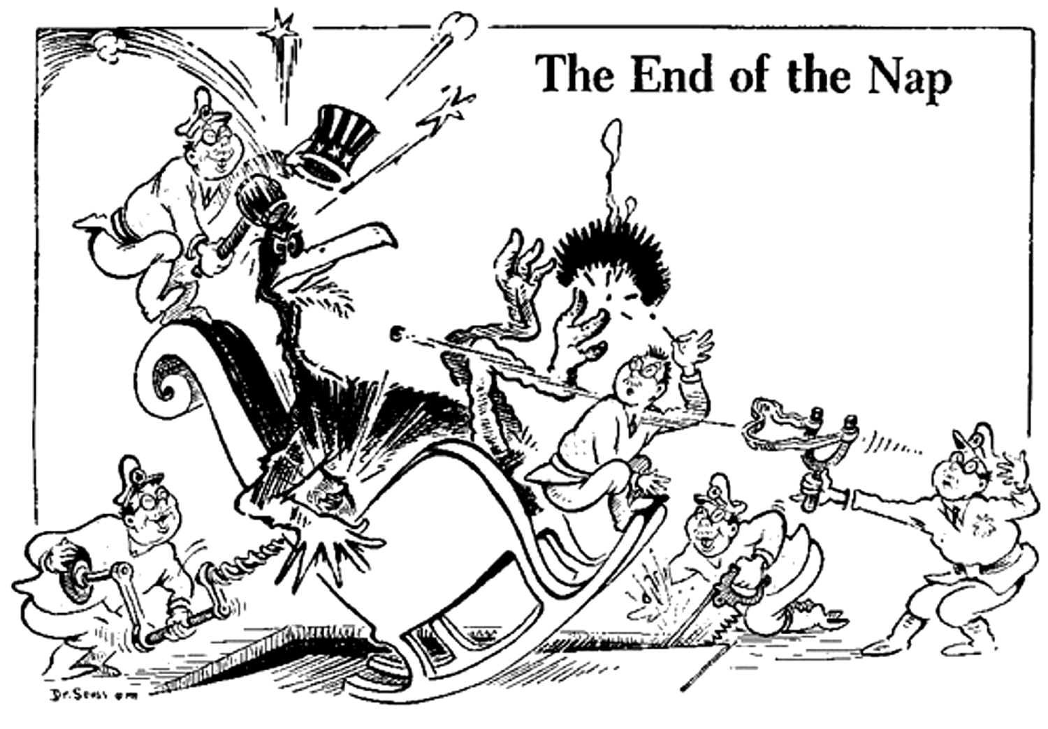
* What point is the illustrator trying to make?

