Slide 1
Origins of the Cold War

Slide 2
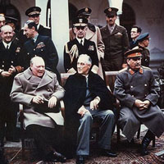
The Yalta Conference:
Roosevelt, Churchill, and Stalin met at Yalta to discuss Poland, Germany, and the rights of liberated Europe.
February 1945
Yalta is a Soviet Resort on the Black Sea
Planned postwar world
Several agreements reached at Yalta played an important role in causing the Cold War

Slide 3
Outcomes
Poland: Two governments were claiming the right to Poland – communist and anti-communist
Stalin wants: Polish government to be friendly with Soviet Union
Roosevelt and Churchill want: Poland to be free and sovereign
COMPROMISE: Polish government set up by Soviets, would include members of pre-war Polish government, free elections would be held as soon as possible

Slide 4
Outcomes
2. Declaration of Liberated Europe
“the right of all people to choose the form of government under which they will live”
PROMISES THE FOLLOWING
1. People of Europe could create democratic institutions of their choice
2. While people are deciding, temporary governments would be set up that represented all democratic elements
3. Final governments will be established through free elections

Slide 5
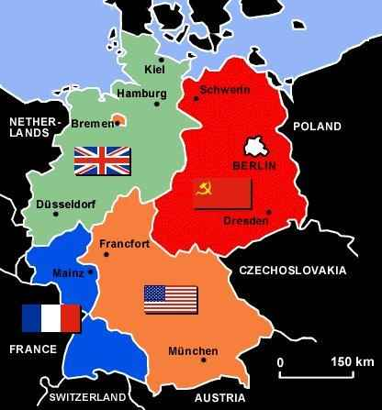
OUTCOMES:
Dividing Germany:
Germany: Country split into four zones (between Great Britain, France, U.S., and Soviets)
Berlin: Also divided into four zones
Stalin: Wants Germany to pay
COMPROMISE: Germans could pay with trade goods instead of cash; did not resolve issue…

Slide 6
Tensions Begin to Rise
2 weeks after Yalta, Soviets pressure Romanian King into creating communist government
US accuses Soviets of violating the DLE
Soviets let no more than 3 non-communist Poles to serve in 18 member Polish government
No indication Soviets were going to hold free elections in Poland
April 1, President Roosevelt informs Soviets their actions are not acceptable

Slide 7
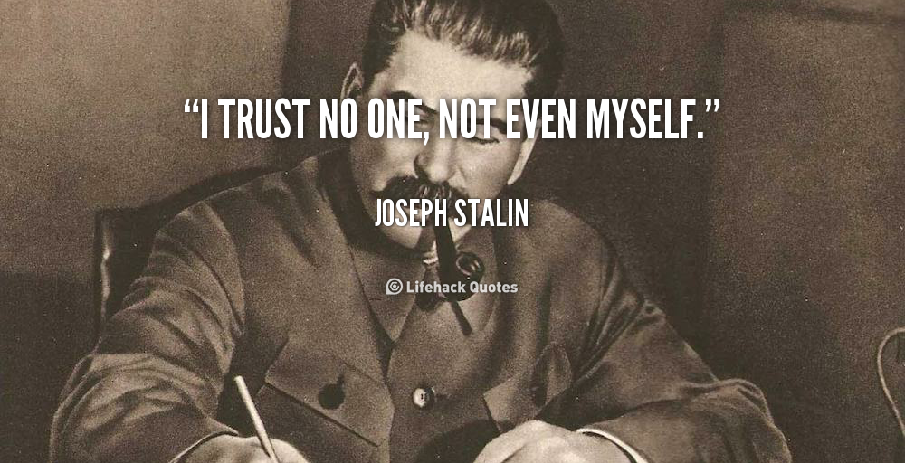
Ironic

Slide 8
With a partner...complete the chart
Communism Capitalism

Slide 9
Americans focused on:
Economic Problems
Soviets focused on:
Securing their borders
Remember – USSR got brutally destroyed during much of WWII...never again wanted that to happen

Slide 10
Here’s what the U.S. believed
Depression had caused WWII
Hitler would never come to power
Japan would not have wanted to expand its empire
Economic growth was the key to peace
When nations stop trading, they are forced into war to get resources

Slide 11
Americans begin promoting democracy and free enterprise
Believed that protections for people’s rights made countries more stable and peaceful
Free enterprise system, with private property rights limited government intervention in the economy (best route to prosperity)

Slide 12
Truman Takes Control:
Roosevelt dies 11 days after confronting Soviets on Poland
Truman is anti-communist
Believed the war had been started because Britain appeased Hitler
“We must stand up to the Russians”
Truman told a Soviet Foreign minister that Stalin must hold free elections as he promised
The meeting marked an important shift in Soviet-American relations

Slide 13
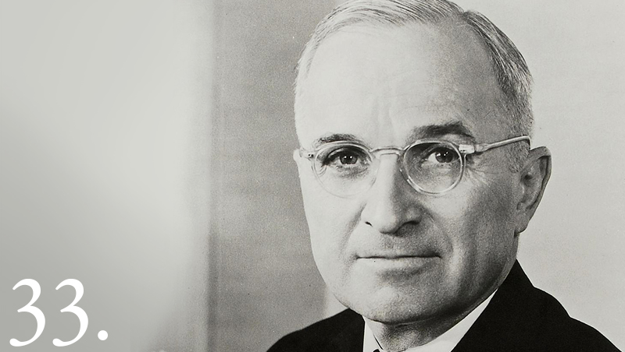
The Potsdam Conference
TRUMAN:
Takes a firm stand against heavy German reparations
Suggests Soviets take reparations from their zone, Allies would allow industry to revive in their zone

Slide 14
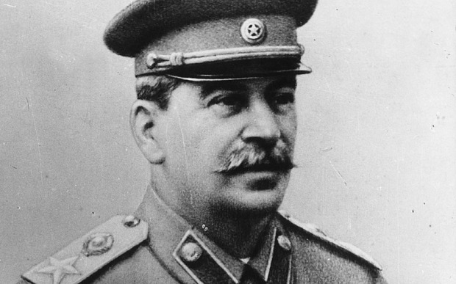
The Potsdam Conference
STALIN
Force Germany to pay reparations or allow the Soviet Union to confiscate industrial infrastructure
Allows the Soviet Union to take industrial materials from the more industrial Western Germany

Slide 15
The Potsdam Conference
OUTCOMES
Tensions are at the highest.
The Atomic Bomb exchange creates the root of the tensions between the Soviets and America

Slide 16
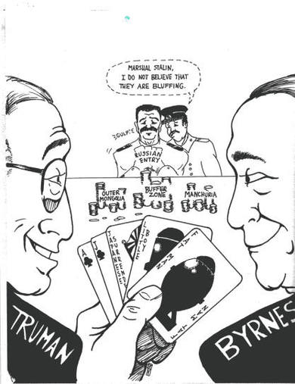
Read Excerpts on Stalin and Truman
2 volunteers to read aloud
Blue book

Slide 17
The Iron Curtain Descends:
Truman won argument over reparations, but little else
Soviets say:
Refuse to make any more commitments to the Declaration of Liberated Europe
Presence of Soviet army in Eastern Europe ensures pro-Soviet communist governments to be set up in Poland, Romania, Bulgaria, Hungary, Czech
These nations become known as the satellite nations
These nations had to remain Communist and friendly to the Soviet Union
Winston Churchill coined the phrase Iron curtain falling across Europe: speech in 1946 in Fulton, Missouri
Iron Curtain refers to the communist nations of Eastern Europe and the Soviet Union
With the Iron Curtain separating the Communist nations of Eastern Europe from the West, the WWII era had come to an end. The Cold War was about to begin.

Slide 19
Truman Doctrine & Marshall Plan
https://www.youtube.com/watch?v=Xyoviiavusk

