Slide 1
Hoover V. Roosevelt

Slide 2
Journal
Write a journal entry as if you were someone trying to survive during the Great Depression, based on what you learned last class. Describe your whole day in as much detail as you can.
While you’re doing this, I’ll be calling up the class in groups to go over their grades. Bring your planner, when I call your group up.
Use the whole time to write your entry! No phones during this journal activity

Slide 3
Announcements
Missing Work Due Date Reminder – FRIDAY DEC 15th
Upcoming Test - FINAL MONDAY DEC 18th
Remind me if you’re not going to be here, even if you already talked to me
ESSAY REWRITES – Due Friday Dec 15th as well.

Slide 4
The Dust Bowl
http://www.history.com/topics/us-presidents/herbert-hoover/videos/black-blizzard
What would the consequences of such an event be?
What stood out to you the most from that video?

Slide 5
The Dust Bowl
The Dust Bowl was a “natural” disaster that devastated the Midwest during the 1930s
Farmers had extensively plowed fields all along the Great Plains which loosened the top soil
A drought turned that soil to dust and created massive dust storms or “black blizzards”
Visibility in the plains during the storms was 3 feet!

Slide 6
The Dust Bowl
“Okies” – migrants who left their farms and travelled to places like California to find a better life
What did they find?

Slide 7
The Dust Bowl
On your note sheet, write 4 sentences comparing life in the Dust Bowl and Hoovervilles. Which would you have rather tried to live in?

Slide 8
Government Initially believed in Rugged Individualism
“Pick yourself up by your bootstraps”
The free-market will cure itself

Slide 9
Response: Hoover v. Roosevelt
The majority of this assignment will be done individually, but you will need a partner for some of it. Find someone in the class to be your partner and choose which of you will be an expert on Herbert Hoover and which will be an expert on Franklin D. Roosevelt.
Then follow the instructions on your note sheet.

Slide 10
Response: Hoover v. Roosevelt
Hoover opposed the idea of using the government to provide welfare.
Thought private charities should be the ones doing it, but they didn’t have enough resources
Public Works- Government financed building projects
Helped get people jobs, but there weren’t nearly enough for all the unemployment

Slide 11
People’s Response
Farmers started to destroy crops to try and increase the prices
Huge groups marched on Washington to try and get some changes
Bonus Marchers-
After WWI, Congress passed a $1,000 bonus for war veterans to get in 1945. A bill got introduced to pay out sooner.
A huge group of veterans marched to make it happen. They failed.
When the police came to clear them out, a police officer shot into the crowd, and the army got called.

Slide 12
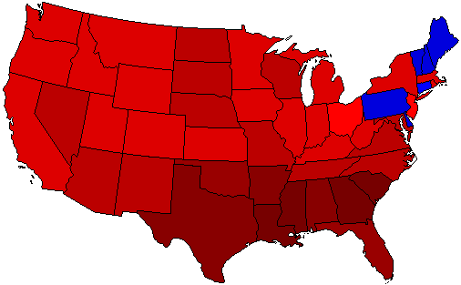
Election of 1932
Franklin Roosevelt | 472 Electoral Votes
Herbert Hoover | 59 Electoral Votes

Slide 13
Review: Life in the Depression

