Slide 1
Immigration Facts

Slide 2
Why are people coming to America? Where are they coming from?

Slide 3
Old Immigrants
Mid 1800’s
Northwestern Europe
England, France, Ireland, Germany
Ex. Irish Potato Famine
Educated, had wealth, Protestant
Easily adapts to American Culture

Slide 4
New Immigrants
Late 1800’s to WWI
Southern and Eastern Europe
Italy, Russia, Poland, Greece and Asian Nations
Culturally different than white Americans, different languages, religions, etc
Struggled adapting to the American Culture…

Slide 5
Push and Pull Factors
Push – pushing them to America
No work
Repressive government
Religious freedom
Pull – Pulling them to American
Better life
More opportunity
American Dream – Rags to Riches
Freedom

Slide 6
Impacts and By the Numbers
By 1890 there were twice as many Irish residents in New York City as in Dublin, Ireland
By 1910 immigrant families made up more than half the total population of 18 major American cities

Slide 8
Ellis Island
Tiny Island in New York harbor
Huge three story building
Served as the processing center
12 million people passed through between 1892 – 1954
11,747 processed on one day 1907
Not all would stay and live in New York

Slide 9
European Immigration

Slide 10
European Immigration

Slide 11
Angel Island
Opened in California for Asian immigrants
Most Asians who immigrated were young men in their teens or twenties
As Japan industrialized, economic problems caused many Japanese to leave
Chinese left for the U.S. because of political instability

Slide 12
Ethnic Cities
Most immigrants were not warmly welcomed into the United States
Immigrants did not want to lose their culture, so they separated into ethnic groups for support
“Little Italy”
“Chinatown”
In their cities they re-created the churches, synagogues, clubs, and newspapers of their homeland
Jacob Riis: “colored to designate nationalities, would show more stripes than on the skin of a zebra.” (Map of New York City)

Slide 13
Nativism
Nativism is an extreme dislike of immigrants by native-born people.
Some people were afraid of Catholicism overtaking the mainly Protestant U.S.
Others did not like how immigrants would work for lower wages
Nativists would strongly persecute immigrants
Do we still see feelings of Nativism today?

Slide 14
Restrictions on Asian Immigration
Anti-Chinese feelings
Railroad to the Gold Rush…
Most Chinese were young hard working men working for low wages...the white worker did not want to compete with that…anomosity rises.
Chinese Exclusion Act: Passed in 1882 by Congress
Banned Chinese Immigration for ten years
Prevented Chinese in country from becoming citizens
Renewed law in 1892, then made it permanent
Law was not repealed until 1943 – THAT’S A LONG TIME!

Slide 16
More Restrictions – The Literacy Debate
Theodore Roosevelt put together a commission to examine how many immigrants were admitted to the country
This commission recommended than an English literacy test be given
2 years later another commission suggested the literacy test should be given in the immigrant’s language
These tests reflected bias toward the “new immigrants”

Slide 17
Americanization
Americans expected immigrants to become Americans – which meant letting go of their heritage
Often this process didn’t take place until the second generation
Instead, many built ethnic communities which resembled the old country as closely as possible – language, stores, traditions, etc.
Turn towards people that can help you – the rise of political machines

Slide 18
Discrimination
Ignorance breeds fear. Fear breeds hatred.
These immigrants are who are populating our cities and working for the big businesses – Making them an easy target to be exploited.

Slide 19
What was it like to land on Ellis Island?

Slide 20
Immigration: From the Old World to New
https://www.youtube.com/watch?v=g2xEce5I1Yk&authuser=0

Slide 21
Immigration: Arriving in New York City
https://www.youtube.com/watch?v=RAUP1Csp-hQ&authuser=0

Slide 22
Immigration: Land of Opportunity
https://www.youtube.com/watch?v=4QEylEC8Oys&authuser=0

Slide 23
Immigration: The Melting Pot
https://www.youtube.com/watch?v=yWYVpgOGxKM&t=192s&authuser=0

Slide 24
Immigration: The Closing Door
https://www.youtube.com/watch?v=53PLMQ9Bc08&authuser=0

Slide 25
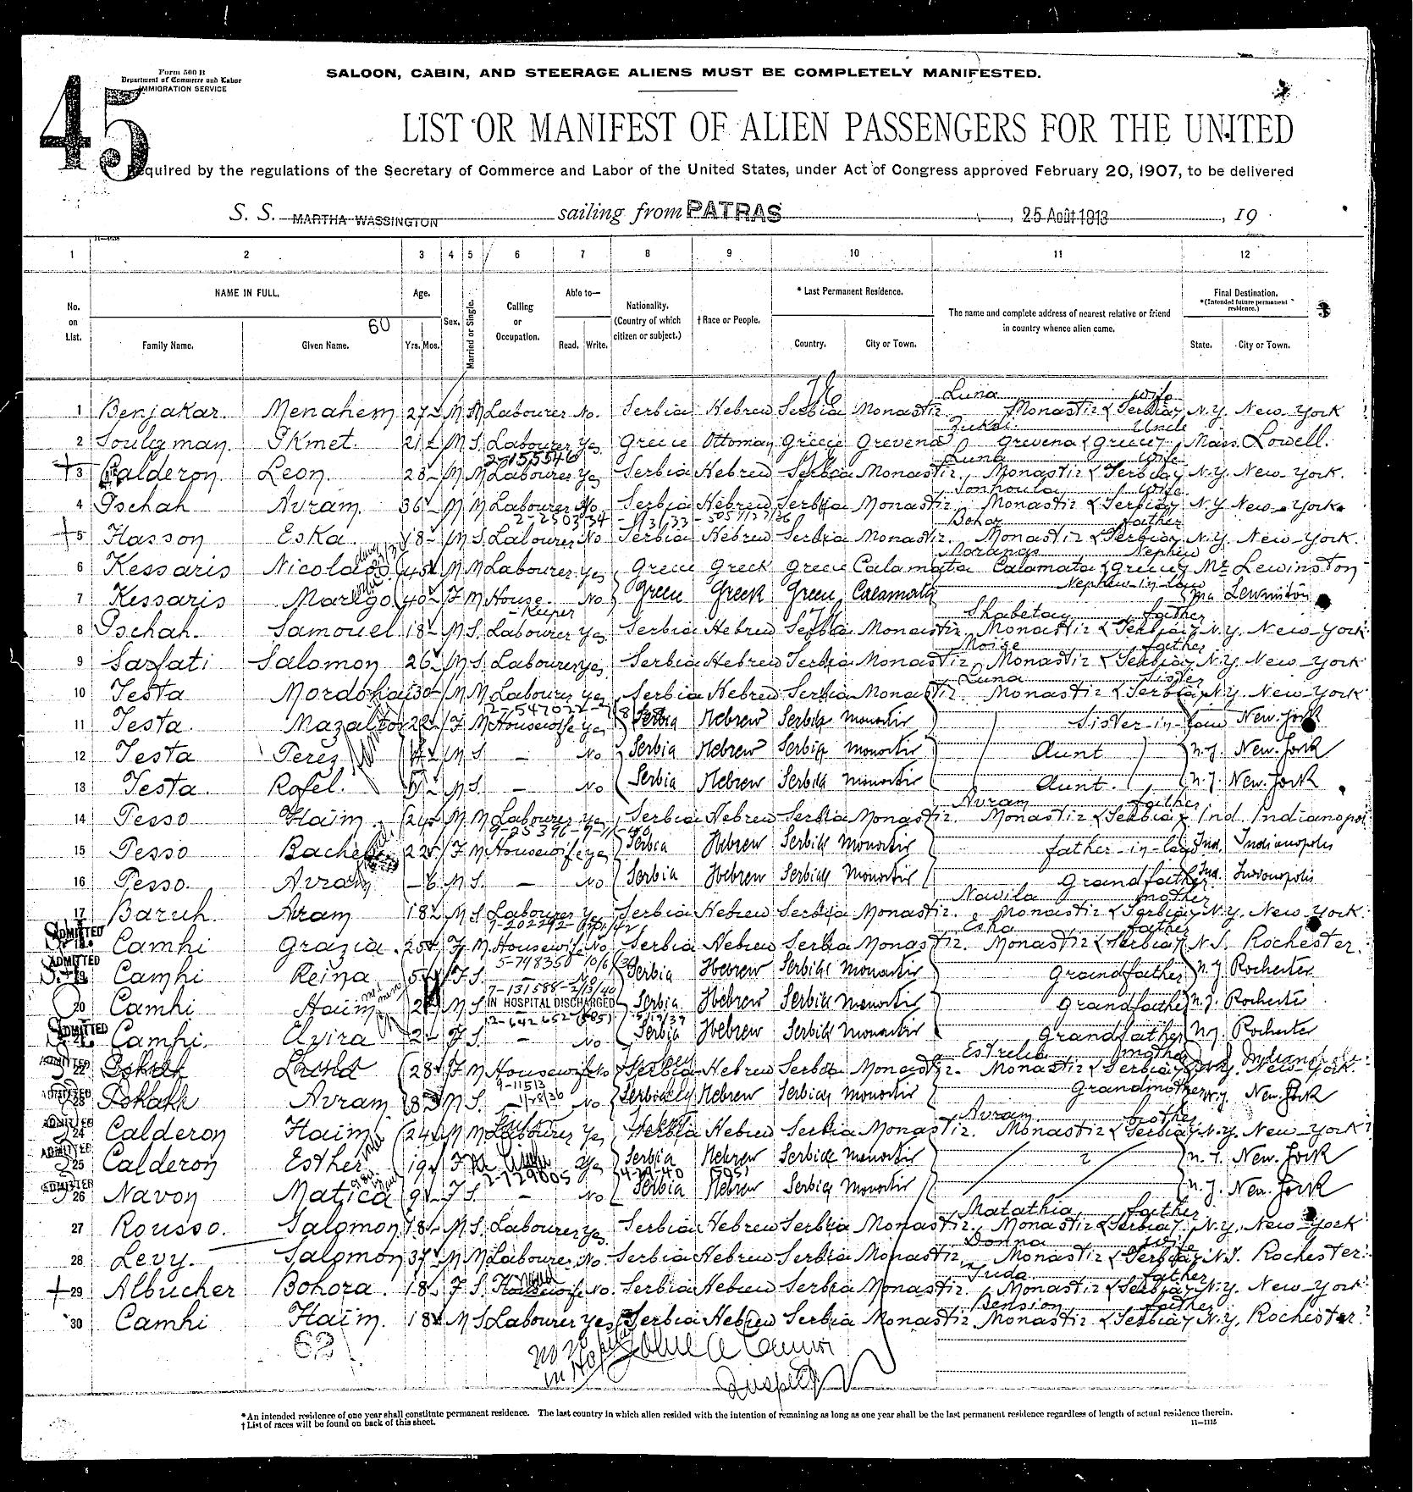
Immigration

Slide 26
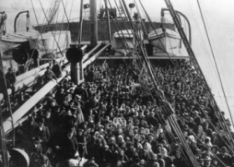
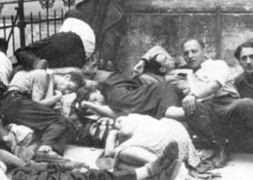
Steerage

Slide 27
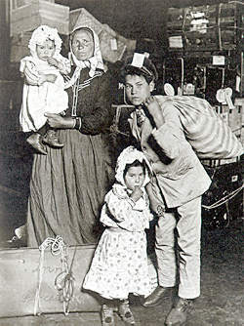

Slide 28
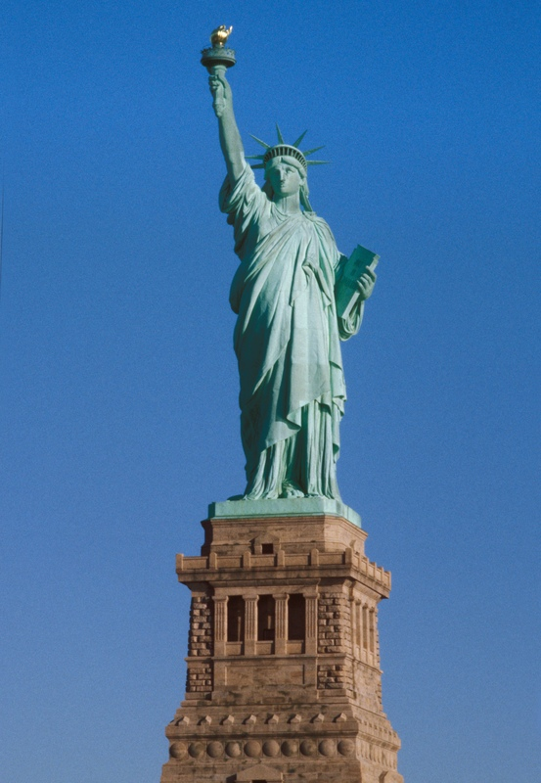

Slide 29
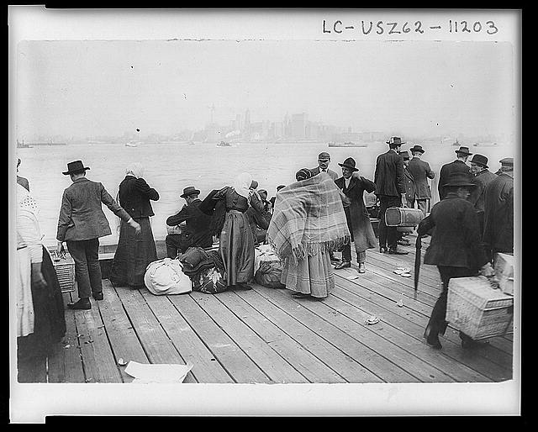
Arriving

Slide 30
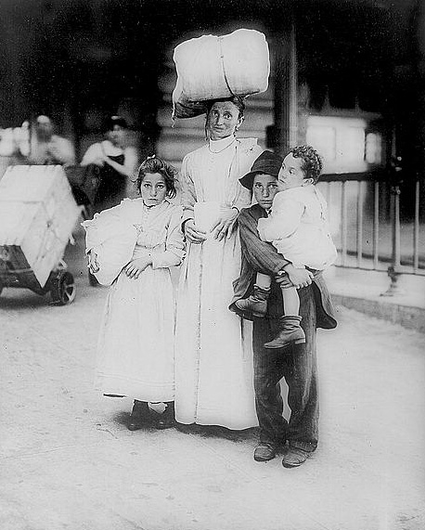

Slide 31
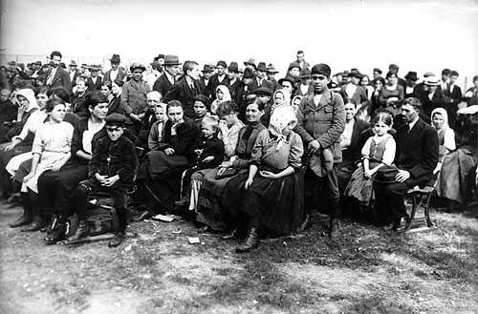
Waiting

Slide 32
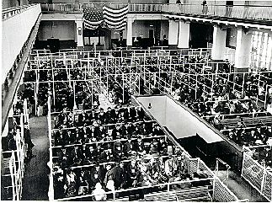

Slide 33
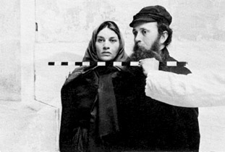
Exams

Slide 34
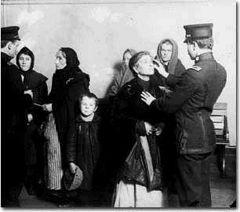

Slide 35
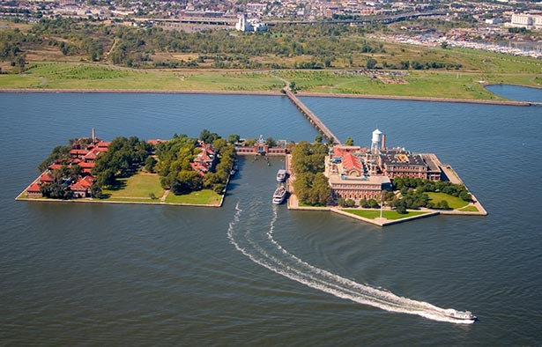

Slide 36
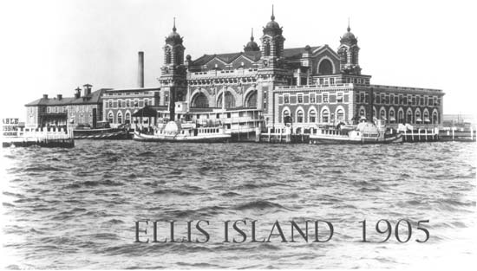

Slide 37
Webquest

