Slide 1
Civil Rights Movement

Slide 2
Discuss the questions…
What is courage?
What things in your life require courage?
What do you think stops people from taking a stand against something they knew was wrong?
What does courage have to do with the quality of your character?
List some examples of when people at school have to show courage.

Slide 3
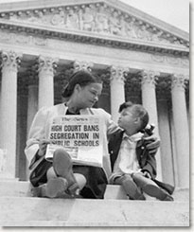
Brown vs Board of Education
http://www.youtube.com/watch?v=TTGHLdr-iak

Slide 4
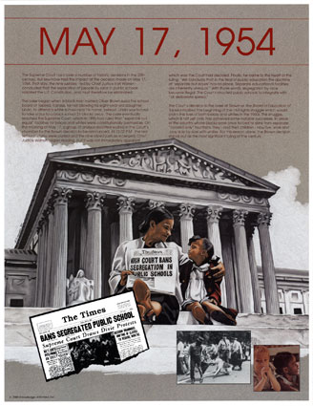
Brown v. Board of Education of Topeka, Kansas
Reversed and overturned Plessy v. Ferguson
Tested at Central High School in Little Rock Arkansas

Slide 5
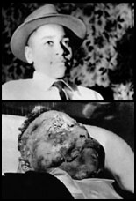
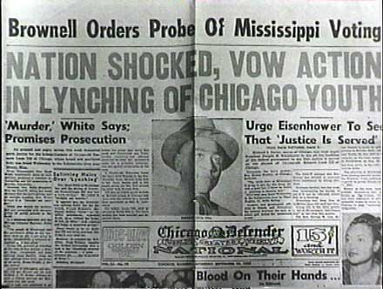
1955 The Murder of Emmett Till
Focused national attention on discrimination and segregation

Slide 6
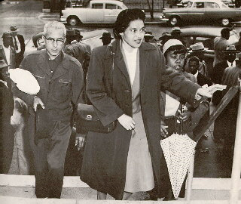
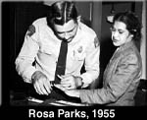
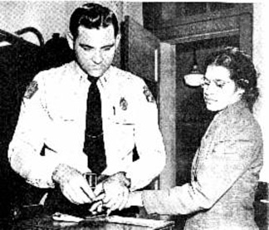
December 1, 1955
Many site this event as the start of the Civil Rights Movement

Slide 7
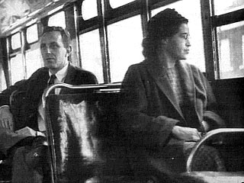
Happened in Montgomery Alabama
Boycott led by Martin Luther King Jr.

Slide 8
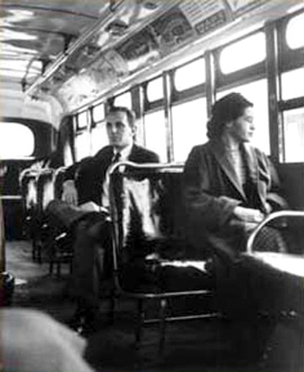
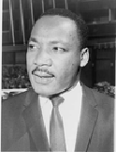
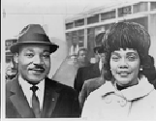
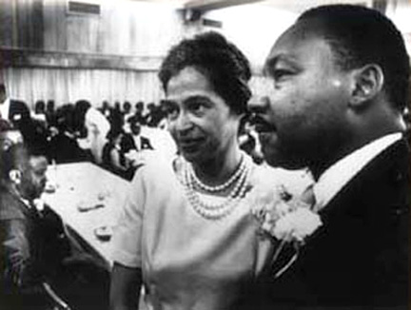
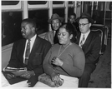
Martin Luther King

Slide 9
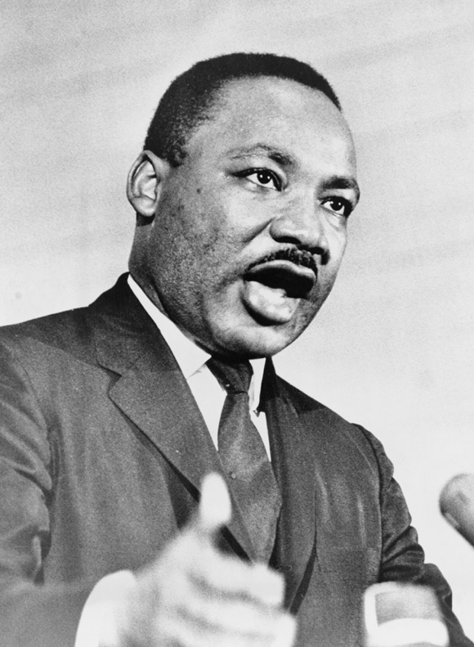
Martin Luther King Jr.
Inspired by Ghandi’s non-violence to overturn unjust laws
Jailed in Birmingham
Gave “I Have a Dream” speech at Washington D.C.

Slide 10
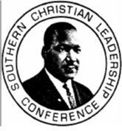
1957
January
Southern Christian Leadership Conference created.
Led by Martin Luther King, Charles K. Steele, and Fred L. Shuttlesworth
September
9 blacked students denied admission into all-white school.
Desegregation enforced by President Eisenhower.
Notes:
Nonviolence and civil disobedience were advocated by a newly formed group called the Southern Christian Leadership Conference. This group was established by Martin Luther King Jr., Charles K. Steele, and Fred L. Shuttlesworth. Also, 9 black students were refused admission into the all-white school Central High School. The black students, however, were backed up by President Eisenhower, federal troops, and the National Guard.

Slide 11
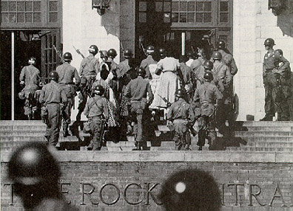
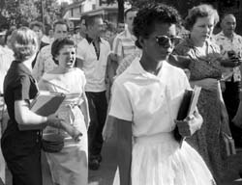
Little Rock Arkansas
Central High School 1957

Slide 12
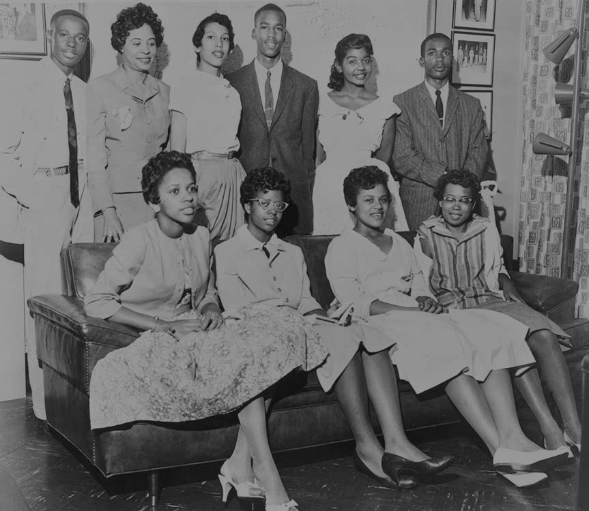
Little Rock 9

Slide 13
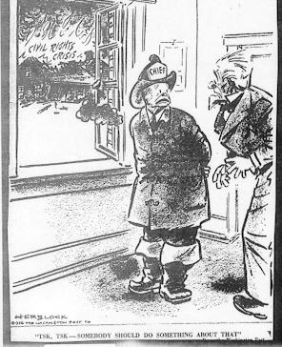

Slide 14
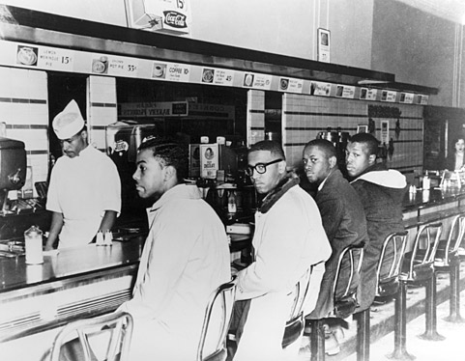
Sit-ins
1960 at a Woolworth lunch counter by four black college students
Started many sit-ins around the country

Slide 15
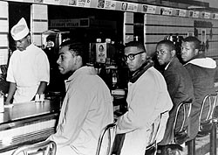
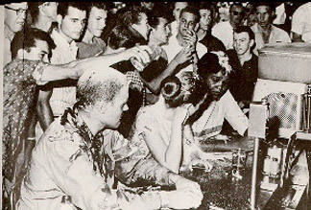
1 February 1960
F.W. Woolworth lunch counter
Birth of the sit-ins
Greensboro, North Carolina

Slide 16
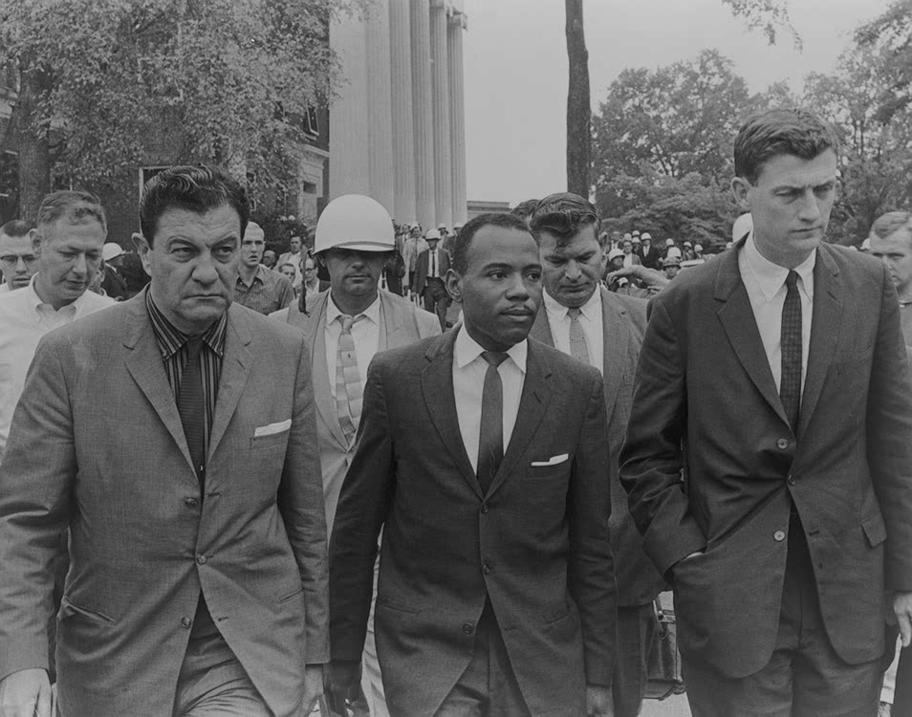
University of Mississippi - James Meredith

Slide 17
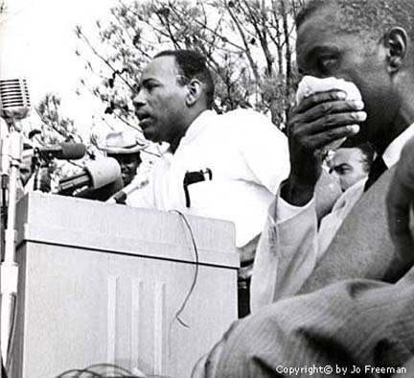
1 October 1962: James Meredith tries to enroll at the
University of Mississippi
3,000 troops
400 Federal Marshalls
2 men killed
many injured
4 million dollars
Taxpayers’ money
1963 Meredith
graduates

Slide 18
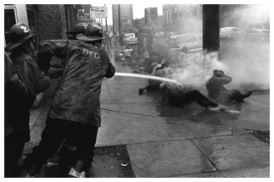
Spring 1963 Birmingham, Alabama: Children’s March

Slide 19
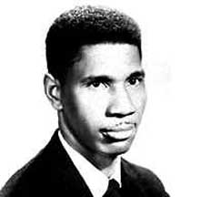
11 June 1963
President Kennedy appears on t.v. to plead for passage of civil rights legislation
“Segregation today,
segregation tomorrow,
segregation forever”
Medger Evers
President of the Mississippi chapter of the NAACP murdered in the driveway of his home

Slide 20
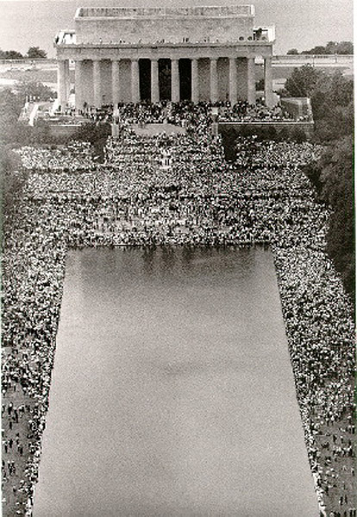
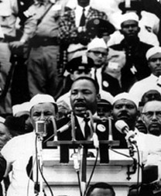
August 1963
March on Washington D.C.
I Have a Dream speech given

Slide 21
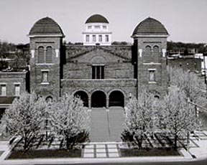
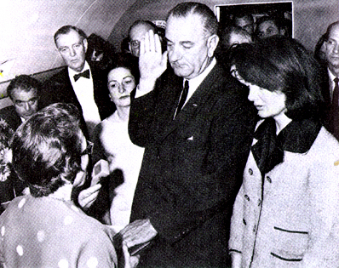
September 1963
4 little girls killed in bomb blast after Sunday School at 16th Street Baptist Church
November 22, 1963
President Kennedy assassinated in Dallas, Texas
Lyndon B. Johnson becomes President of the United States

Slide 22
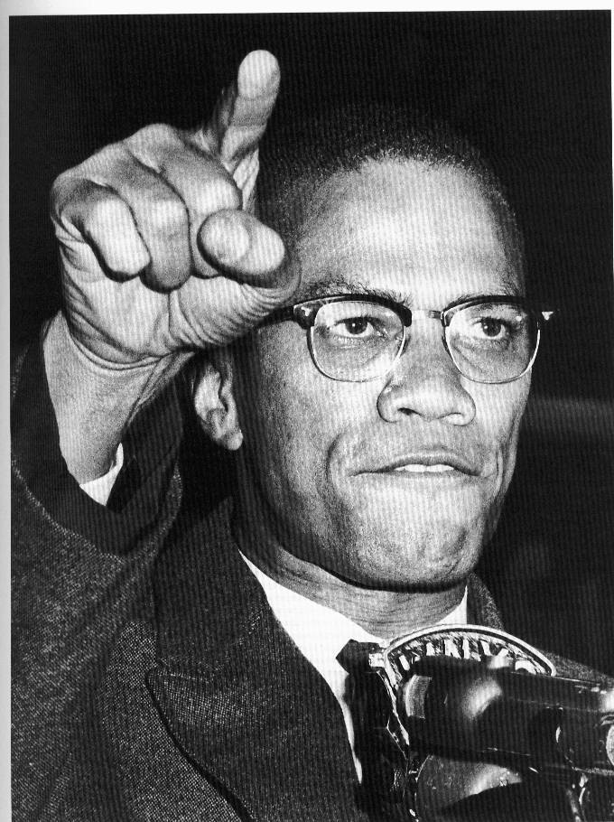
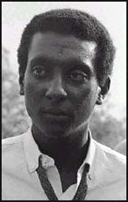
Civil Rights leaders
Malcolm X- spokesperson for the Nation of Islam
Preached black nationalism
Stokely Carmichael-
Black Power movement and Black Panthers
Believed in self defense

Slide 23
Civil Rights Act of 1964
Introduced by Kennedy
Signed by Johnson
What did it do?
Equal pay for women/blacks
Prohibits discrimination based on gender
Racial quotas in schools (forced busing)
Equal voting rights (no literacy tests/poll tax/etc)
Outlaws discrimination in hotels, restaurants, theaters and more.

Slide 24
Civil Rights Act of 1964
Law passed and signed to end discrimination

Slide 25
Johnson’s Great Society
· Pushes through Kennedy’s tax cuts legislation
· Civil Rights Act of 1964 passed: enforces school desegregation and prohibits racial discrimination in public accommodations and in employment
· War on Poverty: Office of Economic Opportunity had it appropriation doubled to $2 billion
· Education Bill appropriated over $1 billion to aid elementary and secondary students
· Medicare Bill passed in 1965 for care of the elderly
· Created two new cabinet offices: 1) Department of Housing and Urban Development (HUD) 2) Department of Transportation
· Named first black Cabinet member: Robert C. Weaver (HUD)

Slide 26
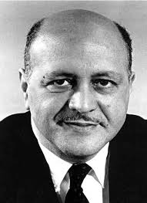
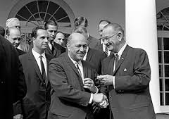
Robert Weaver : Secretary of Housing and Urban Development

Slide 27
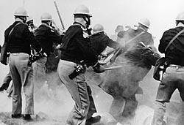
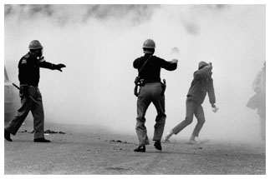
January 1964: 24th Amendment passed – outlawed poll tax
June 1964: 3 civil rights workers disappear in Mississippi
· Beaten bodies found a few days later
· Federal authorities arrest 21 people in connection with their murders
· None are convicted in court
Edmund Pettus Bridge 1965

Slide 28
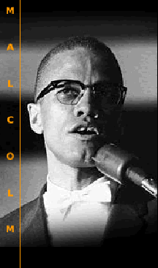
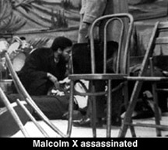
Malcolm X
Nation of Islam · Ballot or the Bullet
1965 while speaking in NYC

Slide 29
Selma
Read the article and answer the questions

Slide 30
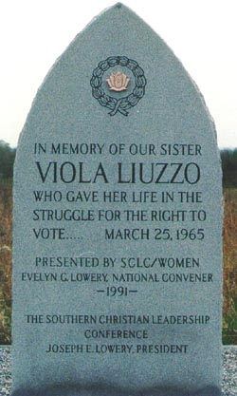
1965 Klansmen in Mississippi gun her down in her car
August 6, 1965
Voting Rights Act of 1965 passed
· outlawed literacy tests
· sent federal voter registrars to southern states
Example of effect: the percentage of blacks registered to vote in the state of Mississippi had risen from 6.7% of the population before 1965 to 66.5% by 1969

Slide 31
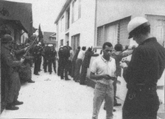
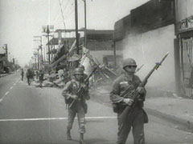
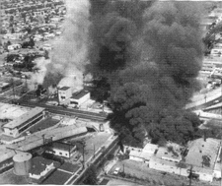
11 August 1965
Watts Riots in Los Angeles
31 blacks and 3 whites killed
Over 1,000 people injured

Slide 32
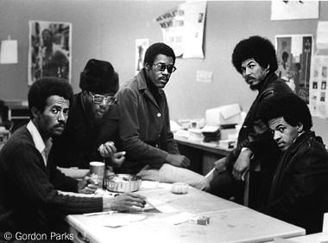
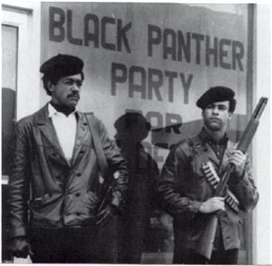
1966 Civil Rights Movement moving Northward and starting to focus on economic equality rather than civil rights equality
Stokely Carmichael · Black Power
Bobby Seale & Huey Newton
Black Panthers

Slide 33
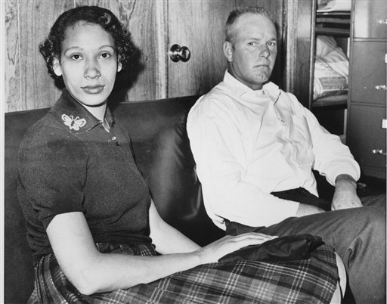
Loving vs. Virginia
June 12, 1967
Prohibiting interracial marriage is unconstitutional
Forcing 16 states to change their laws
Notes:
At this time, there were still 16 that banned interracial marriage. In the court case Loving vs. Virginia, however, this fact was about to become history. The ruling of this case stated that prohibiting such a marriage is unconstitutional. With interracial marriage occurring, it was quite obvious that desegregation was happening at a very quick and successful pace.

Slide 34
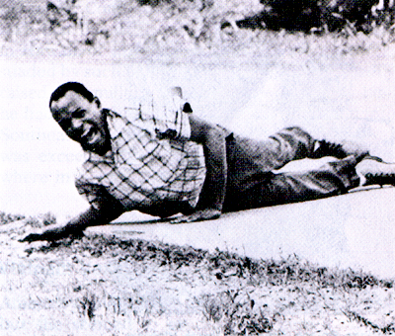
The summer of 1967 became one of riots
· Newark, NJ
25 dead
· Detroit, MI
43 dead
Shocked many Northerners who thought the Civil Rights Movement was just a Southern problem
James Meredith shot while marching from Memphis, Tenn. to Jackson, Miss. to encourage voter registration

Slide 35
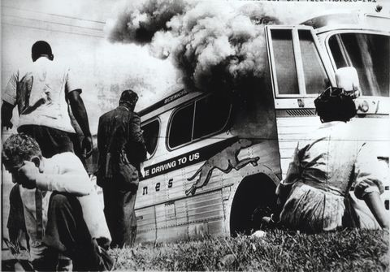
The Freedom Riders
Presentation by Robert L. Martinez
Primary Content Source: American Greats, edited by R. Wilson and S. Marcus.
Images as cited.

Slide 37
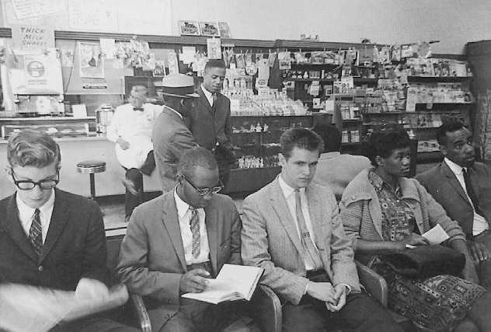
The Freedom Riders challenged Boynton v Virginia in interstate bus terminals across the South in the summer of 1961.
http://biology.clc.uc.edu/fankhauser/Society/freedom_rides/Freedom_Ride_DBF.htm

Slide 38
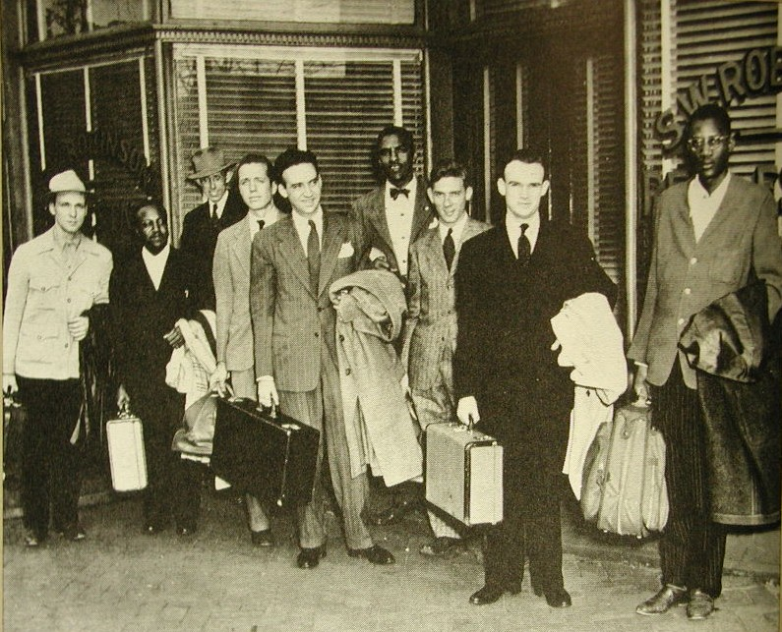
http://biology.clc.uc.edu/fankhauser/Society/freedom_rides/Freedom_Ride_DBF.htm

Slide 39
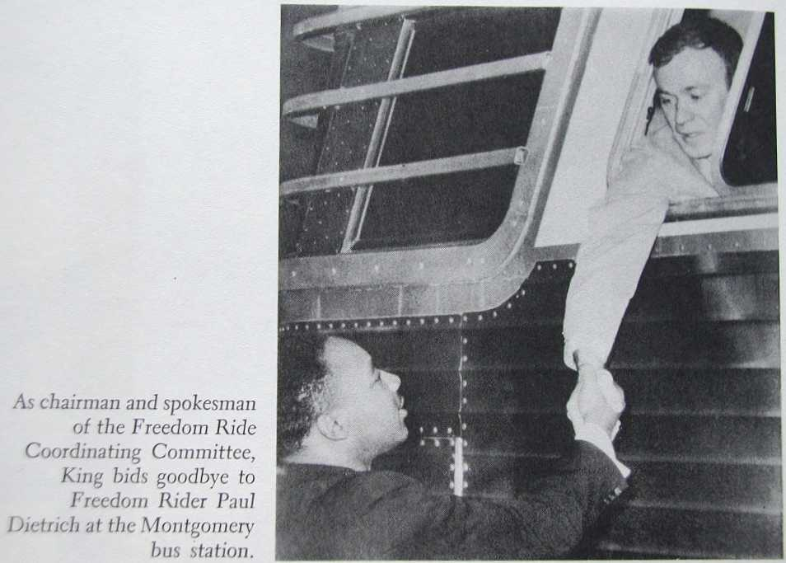
Busloads of students put themselves on the line, enduring beatings, prison terms, and humiliations, until the Kennedy administration, and finally much of the public, awakened and came to their aid.
http://biology.clc.uc.edu/fankhauser/Society/freedom_rides/Freedom_Ride_DBF.htm

Slide 40
Inside the city limits, white Anniston thugs swarmed aboard another Freedom Rider bus, beating Riders mercilessly.
http://biology.clc.uc.edu/fankhauser/Society/freedom_rides/Freedom_Ride_DBF.htm

Slide 41
Outside Anniston, Alabama, a bus had been chased down by fifty cars and firebombed and its passengers barley escaped with their lives.
http://biology.clc.uc.edu/fankhauser/Society/freedom_rides/Freedom_Ride_DBF.htm

Slide 42
http://biology.clc.uc.edu/fankhauser/Society/freedom_rides/Freedom_Ride_DBF.htm

Slide 43
On May 14, Mother's Day, in Anniston, Alabama, a mob of Ku Klux Klansmen, some still in church attire, attacked the first of the two buses (the Greyhound) and slashed its tires. They forced the crippled bus to stop several miles outside of town, and it was firebombed shortly afterwards by the mob chasing it in cars. As the bus burned, the mob held the doors shut, intent on burning the riders to death. Sources disagree, but either an exploding fuel tank or an undercover state investigator brandishing a revolver caused the mob to retreat, allowing the riders to escape the bus. The riders were viciously beaten as they fled the burning bus, and only warning shots fired into the air by highway patrolmen prevented the riders from being lynched. That night, the hospitalized Freedom Riders, most of whom had been refused care, were removed from the hospital at 2 AM, because the staff feared the mob outside the hospital. Local civil rights leader Rev. Fred Shuttlesworth organized several cars of blacks who defied the mob to rescue the injured Freedom Riders.
When the Trailways bus reached Anniston and pulled in at the terminal an hour after the Greyhound bus was burned, it was boarded by eight Klansmen, who proceeded to beat the Freedom Riders and afterwards left them semi-conscious in the back of the bus. When the bus arrived in Birmingham, it too was attacked by a mob of Ku Klux Klan members, aided and abetted by the police under the orders of Commissioner Bull Connor. As the riders exited the bus, they were mercilessly beaten by the mob with baseball bats, iron pipes and bicycle chains. Among the Klansmen attacking the riders was FBI informant Gary Thomas Rowe. White Freedom Riders were particularly singled out for frenzied beatings; James Peck required more than 50 stitches to the wounds in his head. Peck was taken to Carraway Methodist Medical Center, which refused to treat him; he was later treated at Jefferson Hillman Hospital.

Slide 44
Nor did the terror end there. The demonstrators who escaped the buses were often arrested and imprisoned. Others were denied first-aid at local hospitals.
http://breachofpeace.com/blog/wp-content/uploads/2008/04/mugrow1.jpg

Slide 45
Jim Zwerg, a white student from another country, was held down while his teeth were methodically knocked out with his own suitcase.
http://biology.clc.uc.edu/fankhauser/Society/freedom_rides/Freedom_Ride_DBF.htm

Slide 46
“We will continue our journey one way or another….We are prepared to die,”
- Freedom Rider Jim Zwerg
http://www.flickr.com/photos/deedeeq5724/1308144263/

Slide 47
MLK’s Assassination
Died on April 4, 1968 – age 39
Shot in the neck outside his hotel in Memphis Tennessee
MLK had the heart of a 60 year old
James Earl Ray was arrested for his death and sentenced to 99 years in prison – he died there in 1998
Many mark MLK’s death as the END of the Civil Rights Movement

Slide 48
Notes:
On April 4, 1968, a tragic event occurred. Martin Luther King Jr., the hero of civil rights, was shot and killed on the balcony outside his hotel room at the age of 39. This event indeed threw the Civil Rights Movement into chaos although the murderer James Earl Ray was captured and convicted. Seven days later, President Johnson signed the Civil Rights Act of 1968. This act prohibited discrimination in the sale, rental, and financing of housing.

Slide 49
Martin Luther King Jr. assassinated 4 April 1968
in Memphis, Tennessee
Riots will erupt in 125 cities in the U.S.
41 people killed
James Earl Ray convicted of crime

Slide 50
11 April 1968 · Civil Rights Act Title VIII (Fair Housing Act)

Slide 52
1971
April 20
Swann vs. Charlotte-Mecklenburg Board of Education
Upheld busing as legitimate means for integrating schools.
Notes:
In the court case Swann vs. Charlotte-Mecklenburg Board of Education, the court decided that busing was of legitimate means for integrating public schools. In order to correct or balance the race ratios, transportation was extended to reach farther in order to have a fixed about of certain races at each school. This prevented schools from having too many students of any one particular race.

Slide 53
1988/1991
March 22, 1988
Civil Rights Restoration Act
Anti-discrimination laws within private institutes that receive federal funds.
November 22, 1991
Civil Rights Act of 1991
Strengthened and improved federal civil rights laws
Notes:
On March 22, 1988, the Civil Rights Restoration Act was passed in order to enforce anti-discrimination laws within private institutions that receive federal funding. This act was actually passed by overriding President Reagan’s veto. On November 22, 1991, the Civil Rights Act of 1991 was passed in order to strengthen and improve federal civil rights laws.

Slide 54
2003 / Grutter v. Bollinger
June 23
Affirmative Action
Supreme Court says that race can be one of many factors when a college selects it’s students.
Biggest affirmative action decision since the 1978 Bakke case.
Notes:
A conflict over affirmative action was brought to court on June 23, 2003. This was the biggest conflict over this particular topic since the 1978 Bakke case. The Supreme Court decided to uphold the University of Michigan Law School’s policy that uses race as one of many factors when choosing students to admit. The decision was a close one, though, with a 5-4 vote.

Slide 55
2009
January 20
First African-American
President in US History
Barack Obama sworn in on January 20, 2009
Could be considered either the apex or just another event in a series of struggles for civil rights
Notes:
On January 20th, 2009, Barack H. Obama was sworn in as the 44th President of the United States of America - the first African-American ever to hold the office of U.S. Commander-in-Chief. He successfully defeated Republican John McCain, a white man, and created history that would inspire everyone of every race to believe that there is no limit to what one can accomplish.

